Slide 1
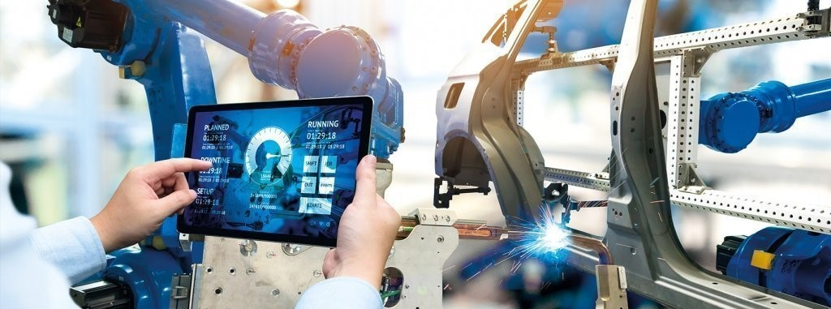
Deep learning for image processing in
manufacturing environment
Masterthesis slides
Aditya Handrale

Slide 2
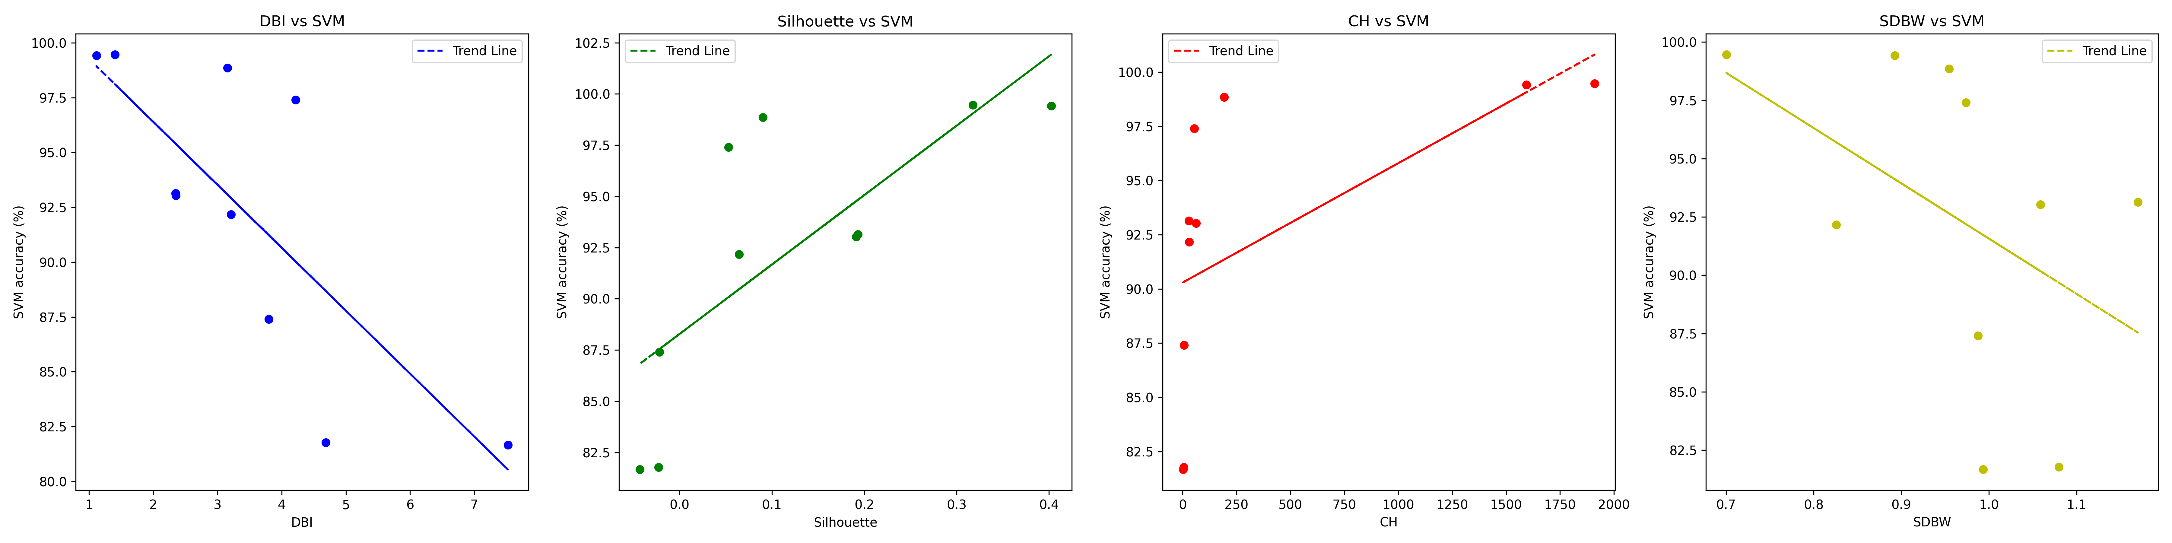
Digging deeper
Fig. SVM performance vs Metrics
Calinski Harabasz score is not very linear (esp. at the start) and thus is not the best indicator for feature space quality
S_dbw had the least correlation (slope) amongst all the ML model accuracies
Davies Bouldin Index and Silhouette index are better indicators of feature space quality, and hence, must be chosen over Calinski Harabasz and S_dbw
Masterthesis discussion
2
Notes:
Ground truth labels may or may not be available in practice, here in our application we habe them available

Slide 3
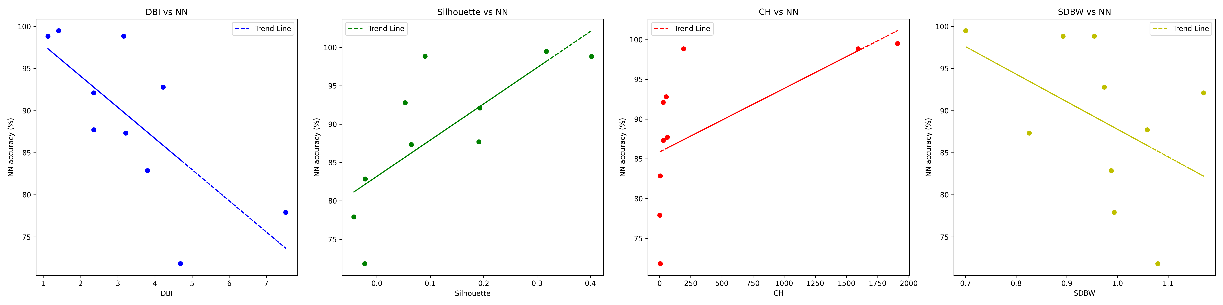
Metrics vs Accuracies
Fig. SVM (top), NN (bottom)
Masterthesis discussion
3
Notes:
Ground truth labels may or may not be available in practice, here in our application we habe them available

Slide 4
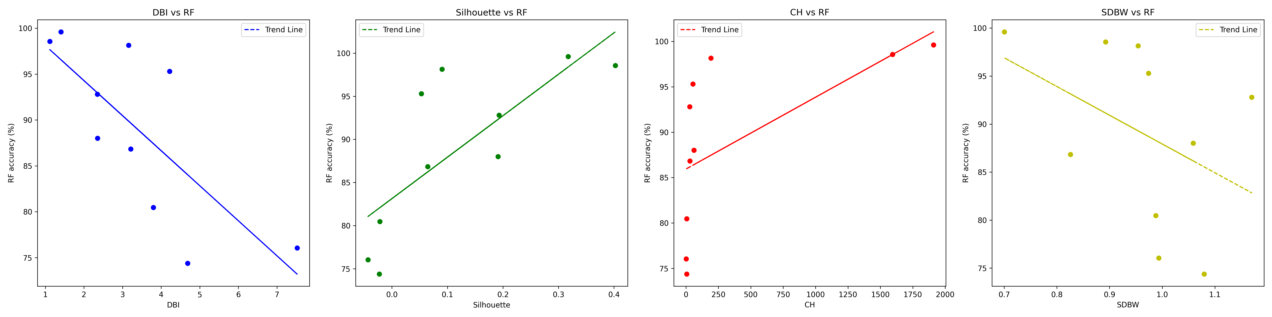
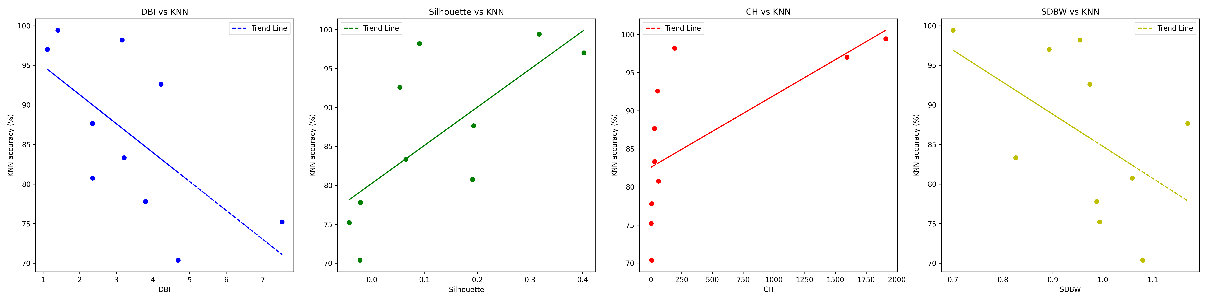
Metrics vs Accuracies
Fig. RF (top), KNN (bottom)
Masterthesis discussion
4
Notes:
Ground truth labels may or may not be available in practice, here in our application we habe them available

Slide 5
Correlations
Metric | SVM | NN | RF | KNN
Silhouette score | 0.74 | 0.76 | 0.76 | 0.71
Davies Bouldin* | -0.77 | -0.73 | -0.75 | -0.65
Calinski Harabasz | 0.58 | 0.61 | 0.60 | 0.66
S_Dbw* | -0.46 | -0.46 | -0.42 | -0.52
Fig. Correlation matrix (green indicates strongest correlation)
Calinski Harabasz and S_Dbw had the least correlation amongst all the models
Silhouette and DBI have the highest correlation with ‘feature space quality’
Metric suitability also depends on the model we are going to use ex: When using SVM, DBI is the best indicator and should be chosen, when using KNN, Silhouette score is a better metric.
For Random forest and Neural networks, Silhouette and DBI have similar performance
Masterthesis discussion
5
Notes:
Ground truth labels may or may not be available in practice, here in our application we habe them available

Slide 6
Clustering
KMeans often performed better than HDBSCAN in most cases
This might be because Kmeans requires K = no. of classes, which was provided, where as HDBSCAN had to guess the number of classes, often assigning more classes than exist
In most datasets, HDBSCAN also labeled majority of points as ‘noise’, sometimes all. This is because as dimensionality increases, everything looks like an outlier
Extrinsic metrics will evaluate the clustering algorithm rather than the feature space (but better clustering also indicates better feature space)
Contrary to previous assumption, extrinsic metrics can be used for measuring feature space quality, since they have a similar correlation with SVM accuracies as Intrinsic metrics
Masterthesis discussion
6
Notes:
Ground truth labels may or may not be available in practice, here in our application we habe them available

Slide 7
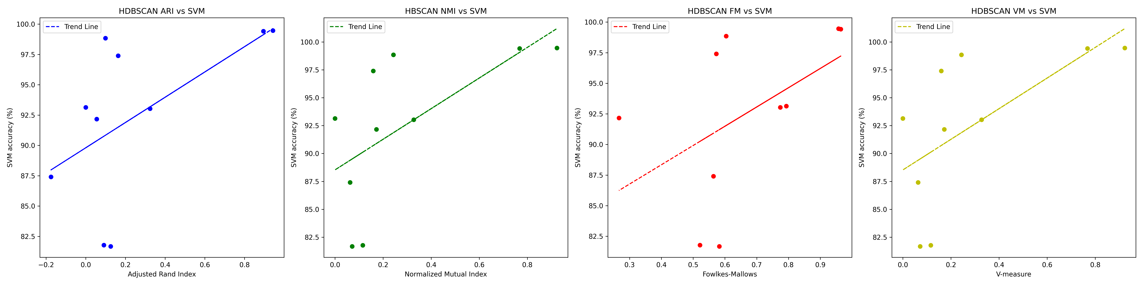
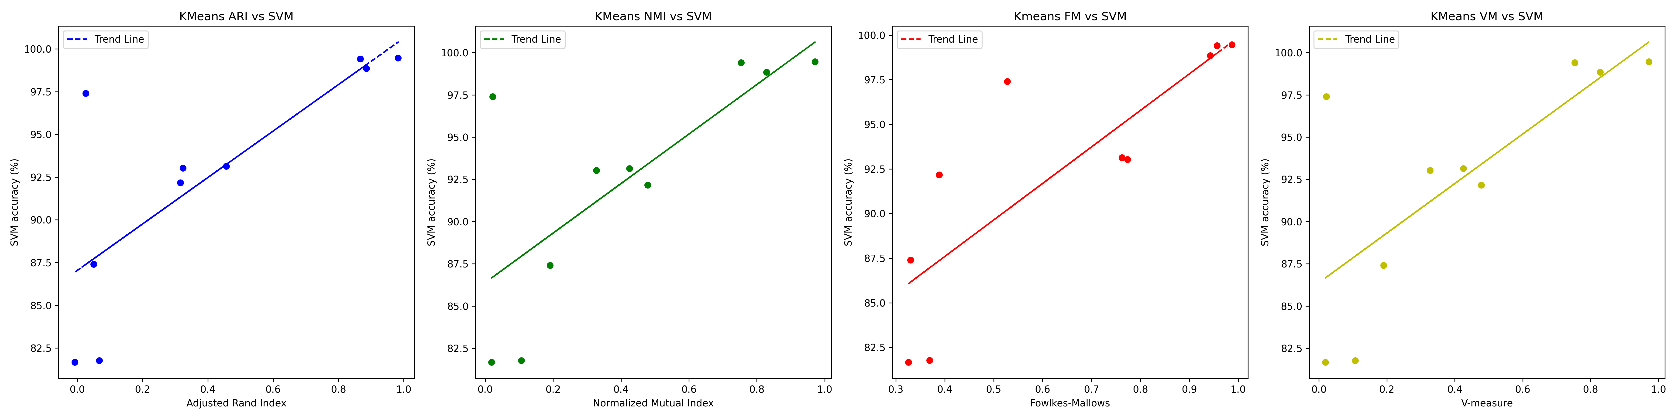
Extrinsic metrics
Fig. HDBSCAN and KMeans extrinsic metrics,
Masterthesis discussion
7
Notes:
Ground truth labels may or may not be available in practice, here in our application we habe them available

Slide 8
Extrinsic metrics
Metric | HDBSCAN | KMeans
Adjusted Rand index | 0.56 | 0.77
Normalized Mutual Index | 0.62 | 0.77
Fowlkes Mallows | 0.49 | 0.82
V-measure | 0.62 | 0.73
Fig. Comparison of KMeans and HDBSCAN metrics
Correlations of metric values vs SVM accuracy on all datasets, (higher number = better).
KMeans metrics were always better for the feature space than of HDBSCAN, because Kmeans clustering was closer to the original
Kmeans clustering metrics also had better correlations with SVM accuracies than HDBSCAN
If extrinsic metrics are going to be used, using KMeans for clustering is the better option
Masterthesis discussion
8
Notes:
Ground truth labels may or may not be available in practice, here in our application we habe them available

Slide 9
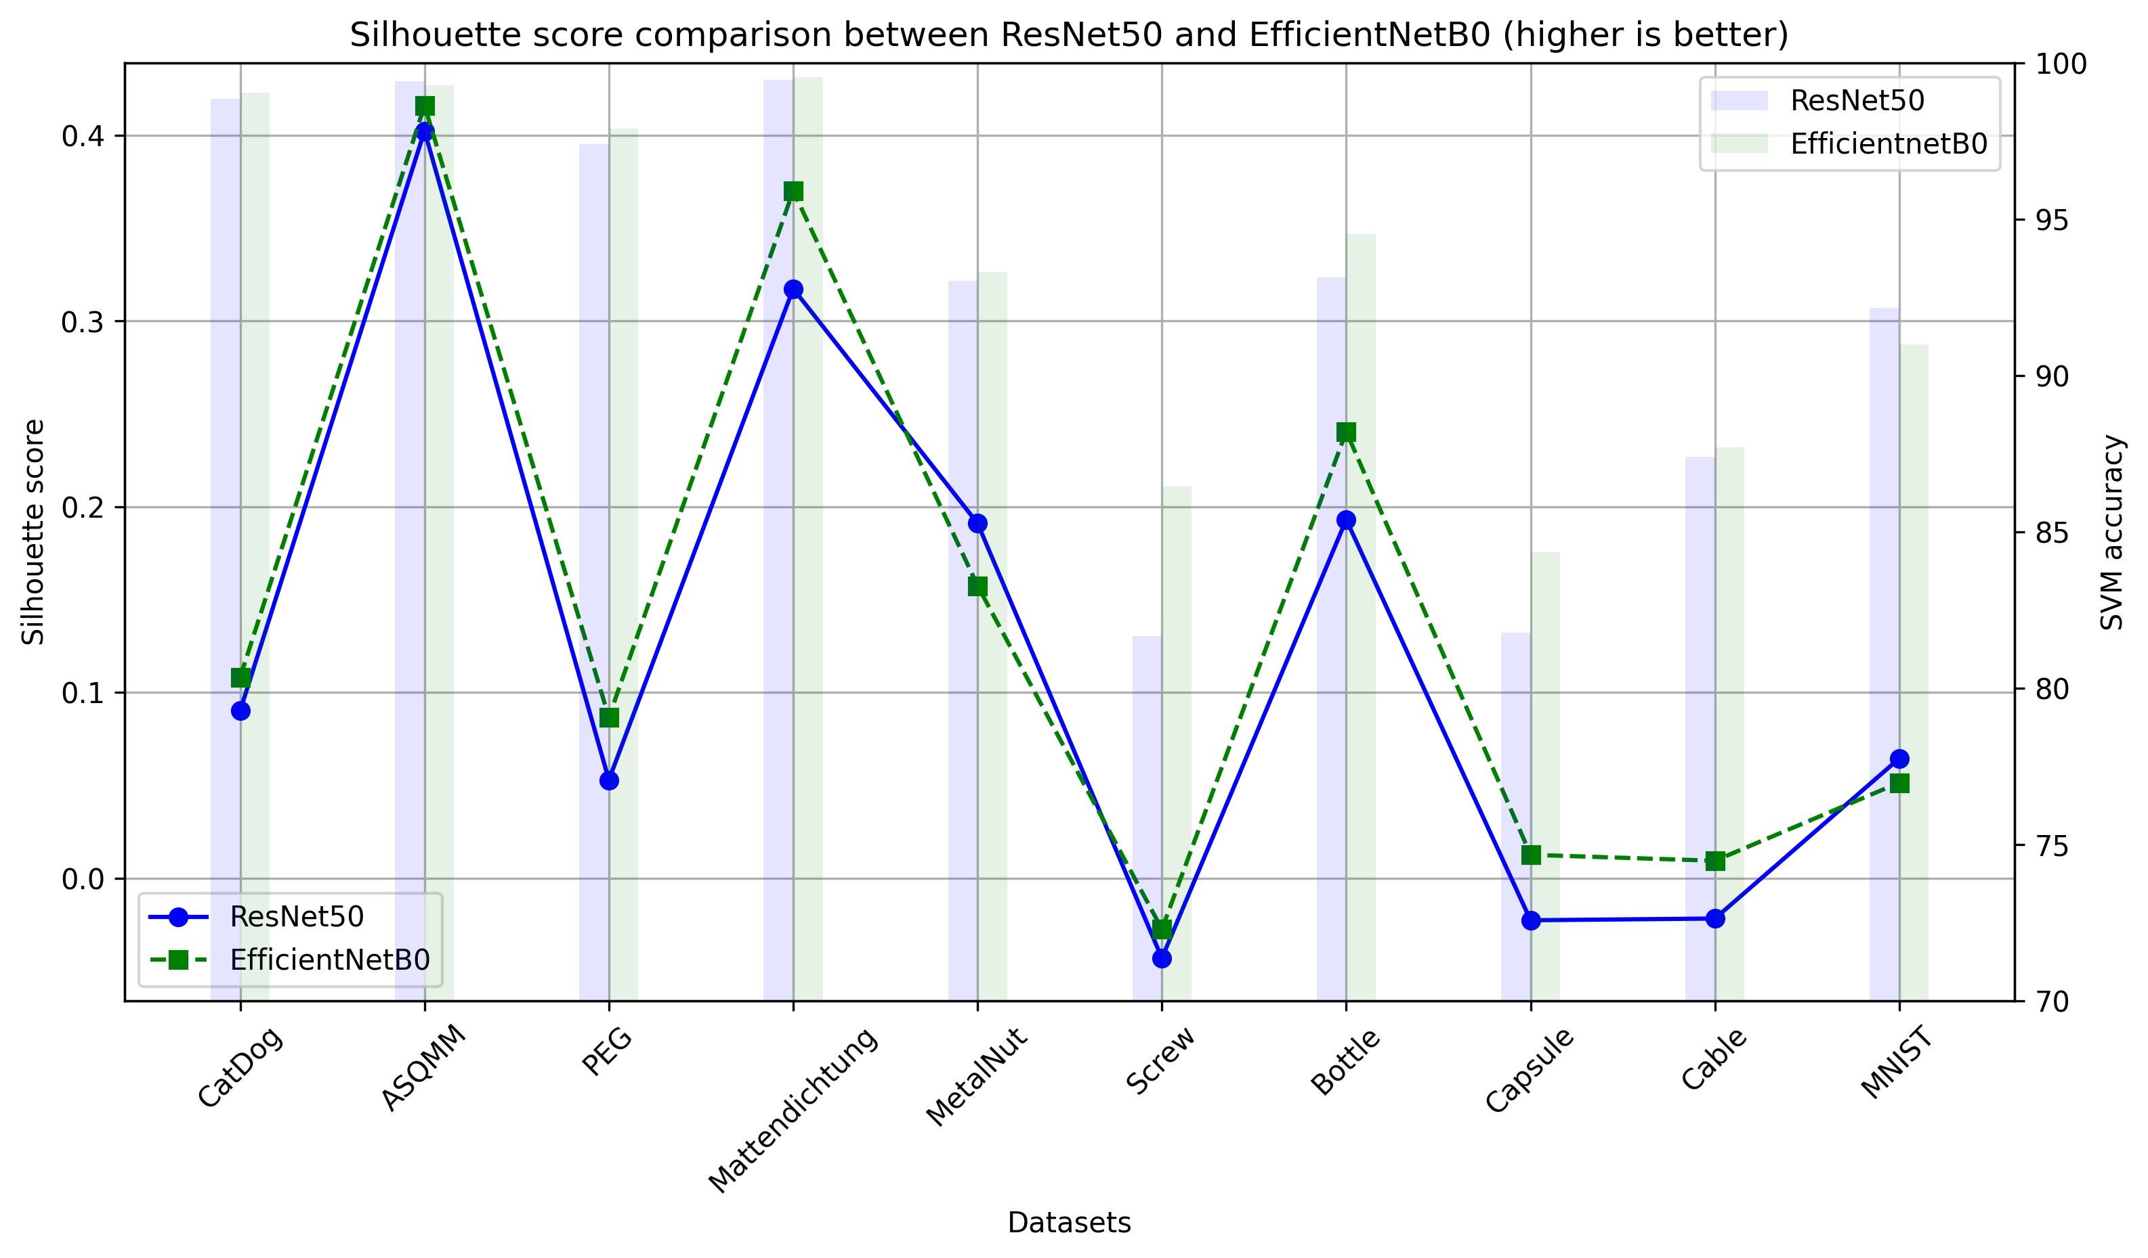
Silhouette Score overview
Fig. Silhouette score
Silhouette score was able to predict the accuracy of ML model (SVM) for 7/10 times
Assumptions regarding SVM accuracy can not be made just by looking at Silhouette ex: >0.1 does not always mean 95-99% ML model performance
Masterthesis discussion
9
Notes:
Ground truth labels may or may not be available in practice, here in our application we habe them available

Slide 10
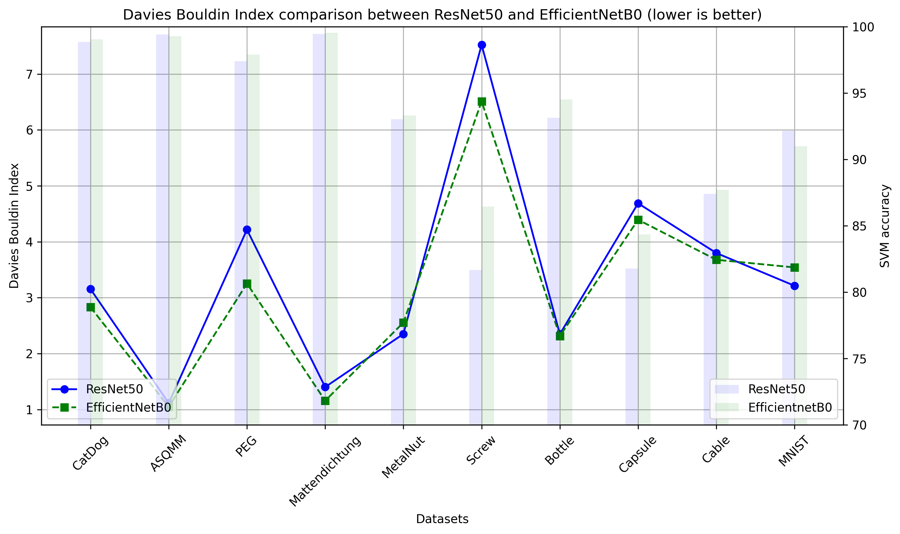
Davies Bouldin Index overview
Fig. Davies Bouldin Index
Davies Bouldin Index was able to predict the accuracy of ML model (SVM) for 8/10 times
Masterthesis discussion
10
Notes:
Ground truth labels may or may not be available in practice, here in our application we habe them available

Slide 11
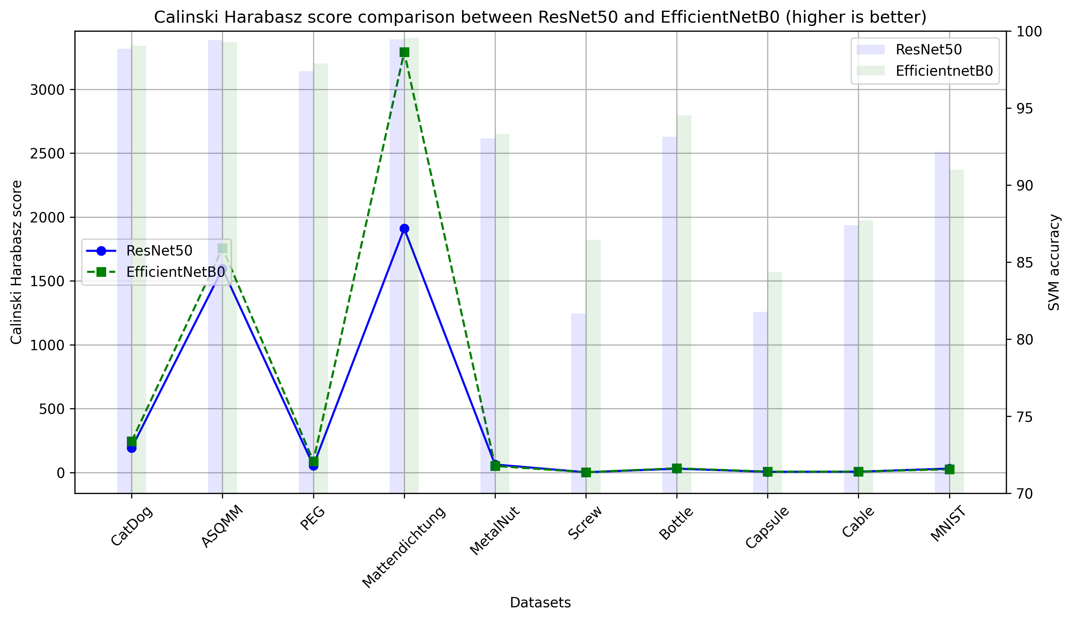
Calinski Harabasz score overview
Fig. Calinski Harabasz
Davies Bouldin Index was able to predict the accuracy of ML model (SVM) for 7/10 times
Masterthesis discussion
11
Notes:
Ground truth labels may or may not be available in practice, here in our application we habe them available

Slide 12
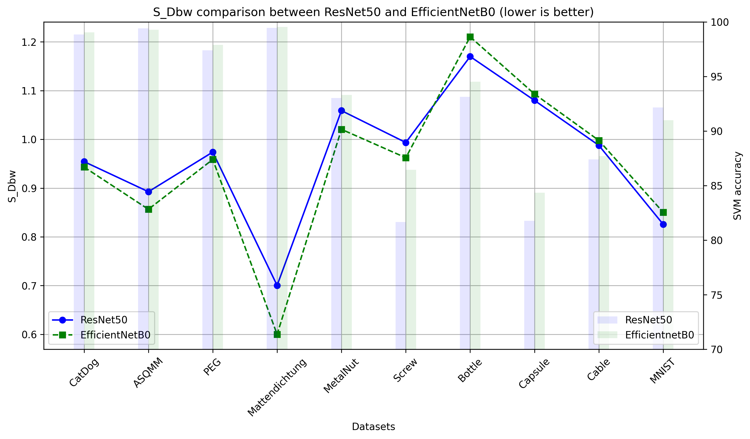
S_Dbw overview
Fig. S_Dbw
S_Dbw was able to predict the accuracy of ML model (SVM) for 6/10 times
No assumptions can be made about one certain value giving the best score
Masterthesis discussion
12
Notes:
Ground truth labels may or may not be available in practice, here in our application we habe them available

Slide 13
Mislabels experiment
Say you receive a ‘faulty’ dataset that you know has many mislabels, they will surely affect our metrics and give us a wrong idea about quality of feature space
How do we ignore these mislabels to get an approximate quality of feature space
Experiment : Mislabeled 5, 10, 15, 20, 25, 30, 50, 80 and 100% of the data automatically
All metrics go down, intrinsic as well as extrinsic
Masterthesis discussion
13
Notes:
Ground truth labels may or may not be available in practice, here in our application we habe them available

Slide 14
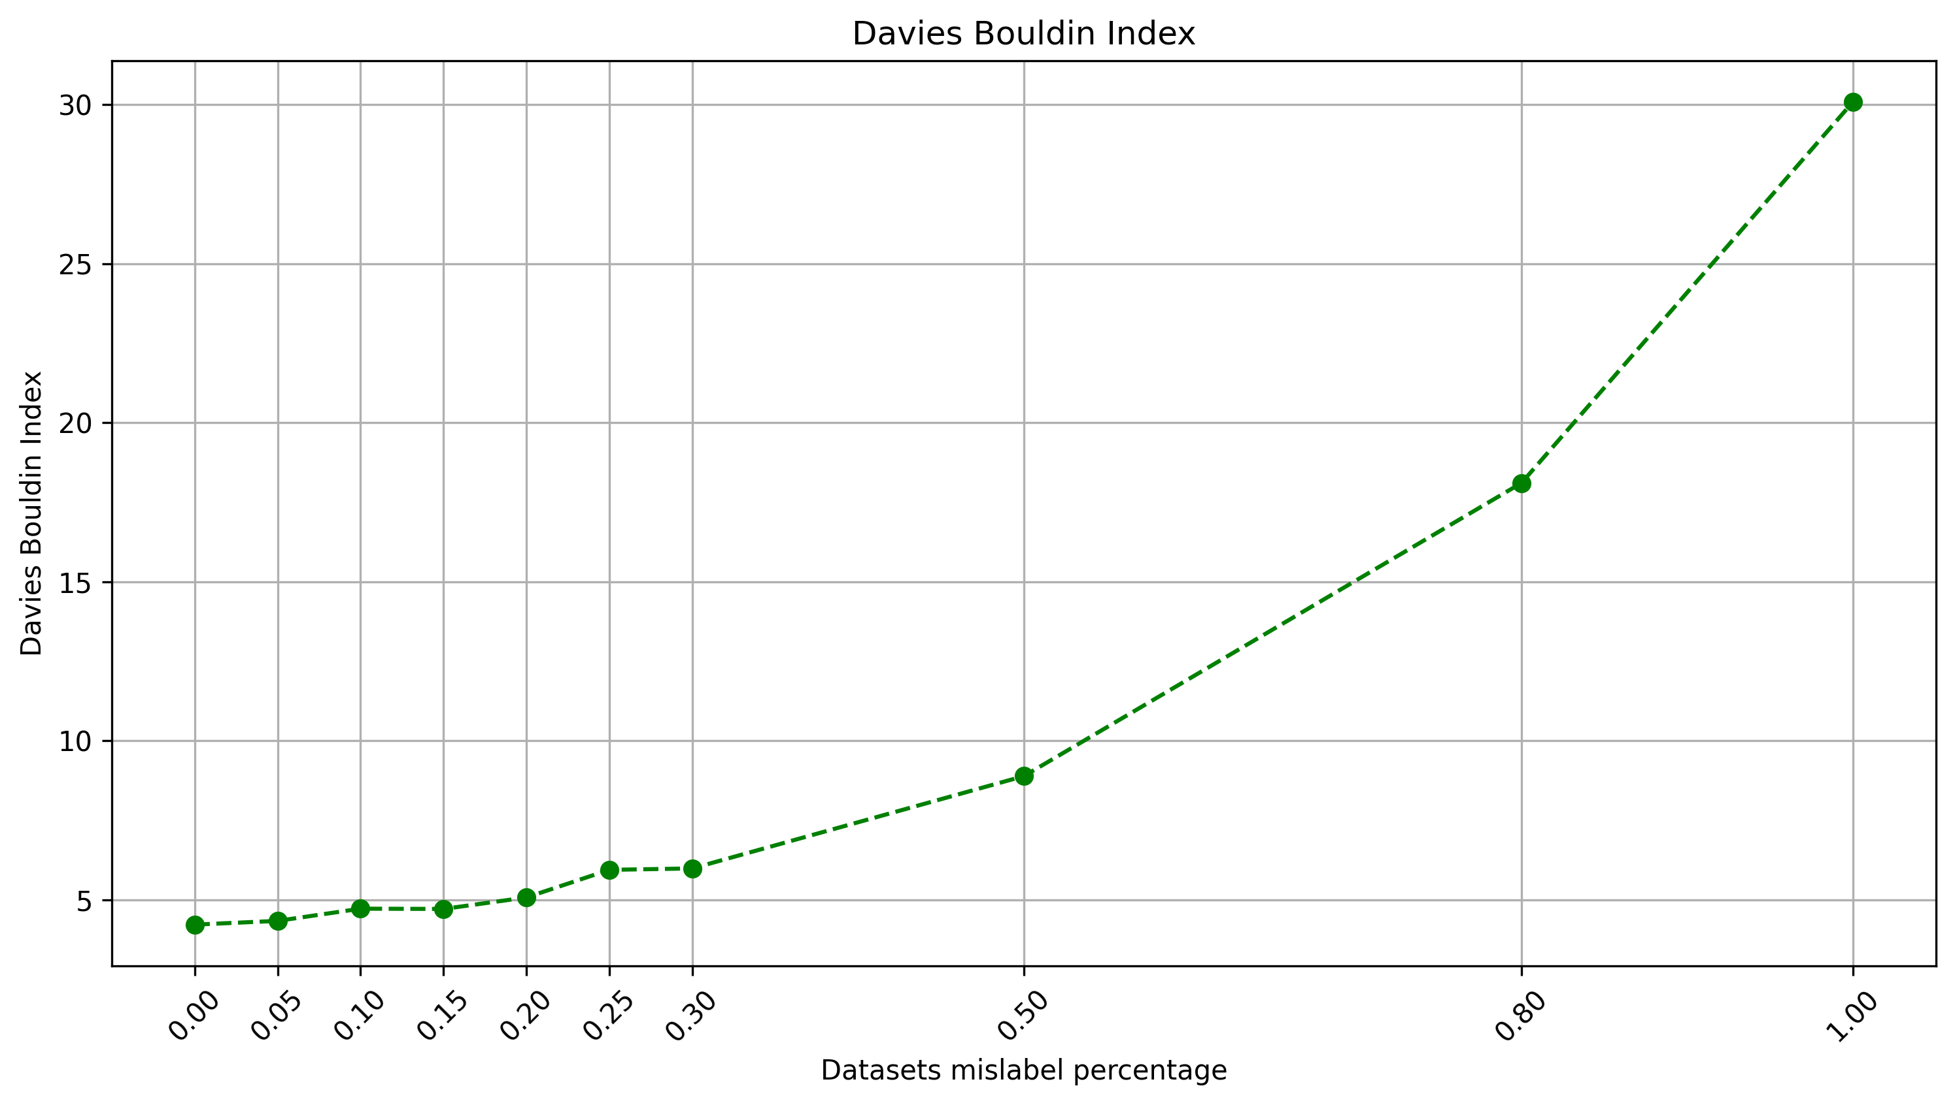
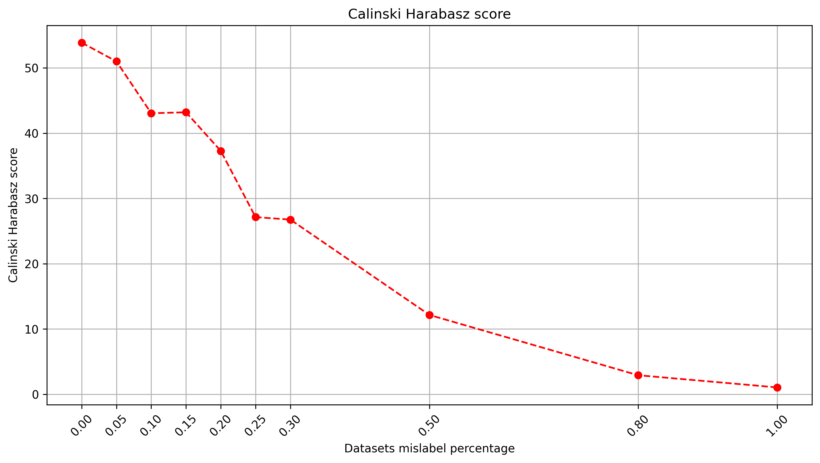
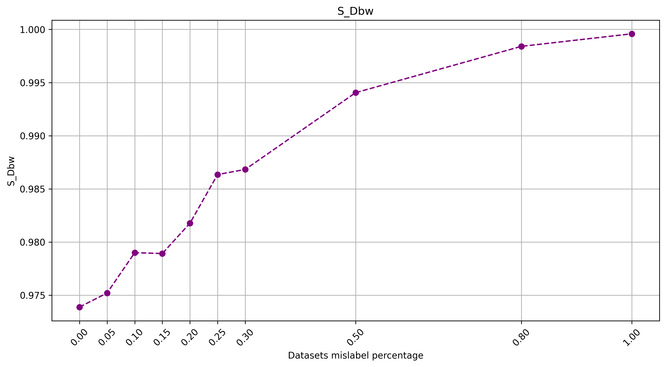
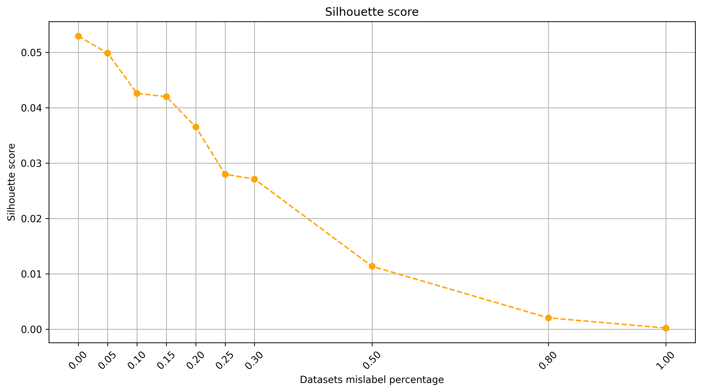
Mislabels experiment
Fig. Mislabels percentage vs Metrics (PEG Dataset)
But if we calculate intrinsic metrics after performing clustering, we can “ignore” the mislabels and get the true quality of the feature space
Masterthesis discussion
14
Notes:
Ground truth labels may or may not be available in practice, here in our application we habe them available

Slide 15
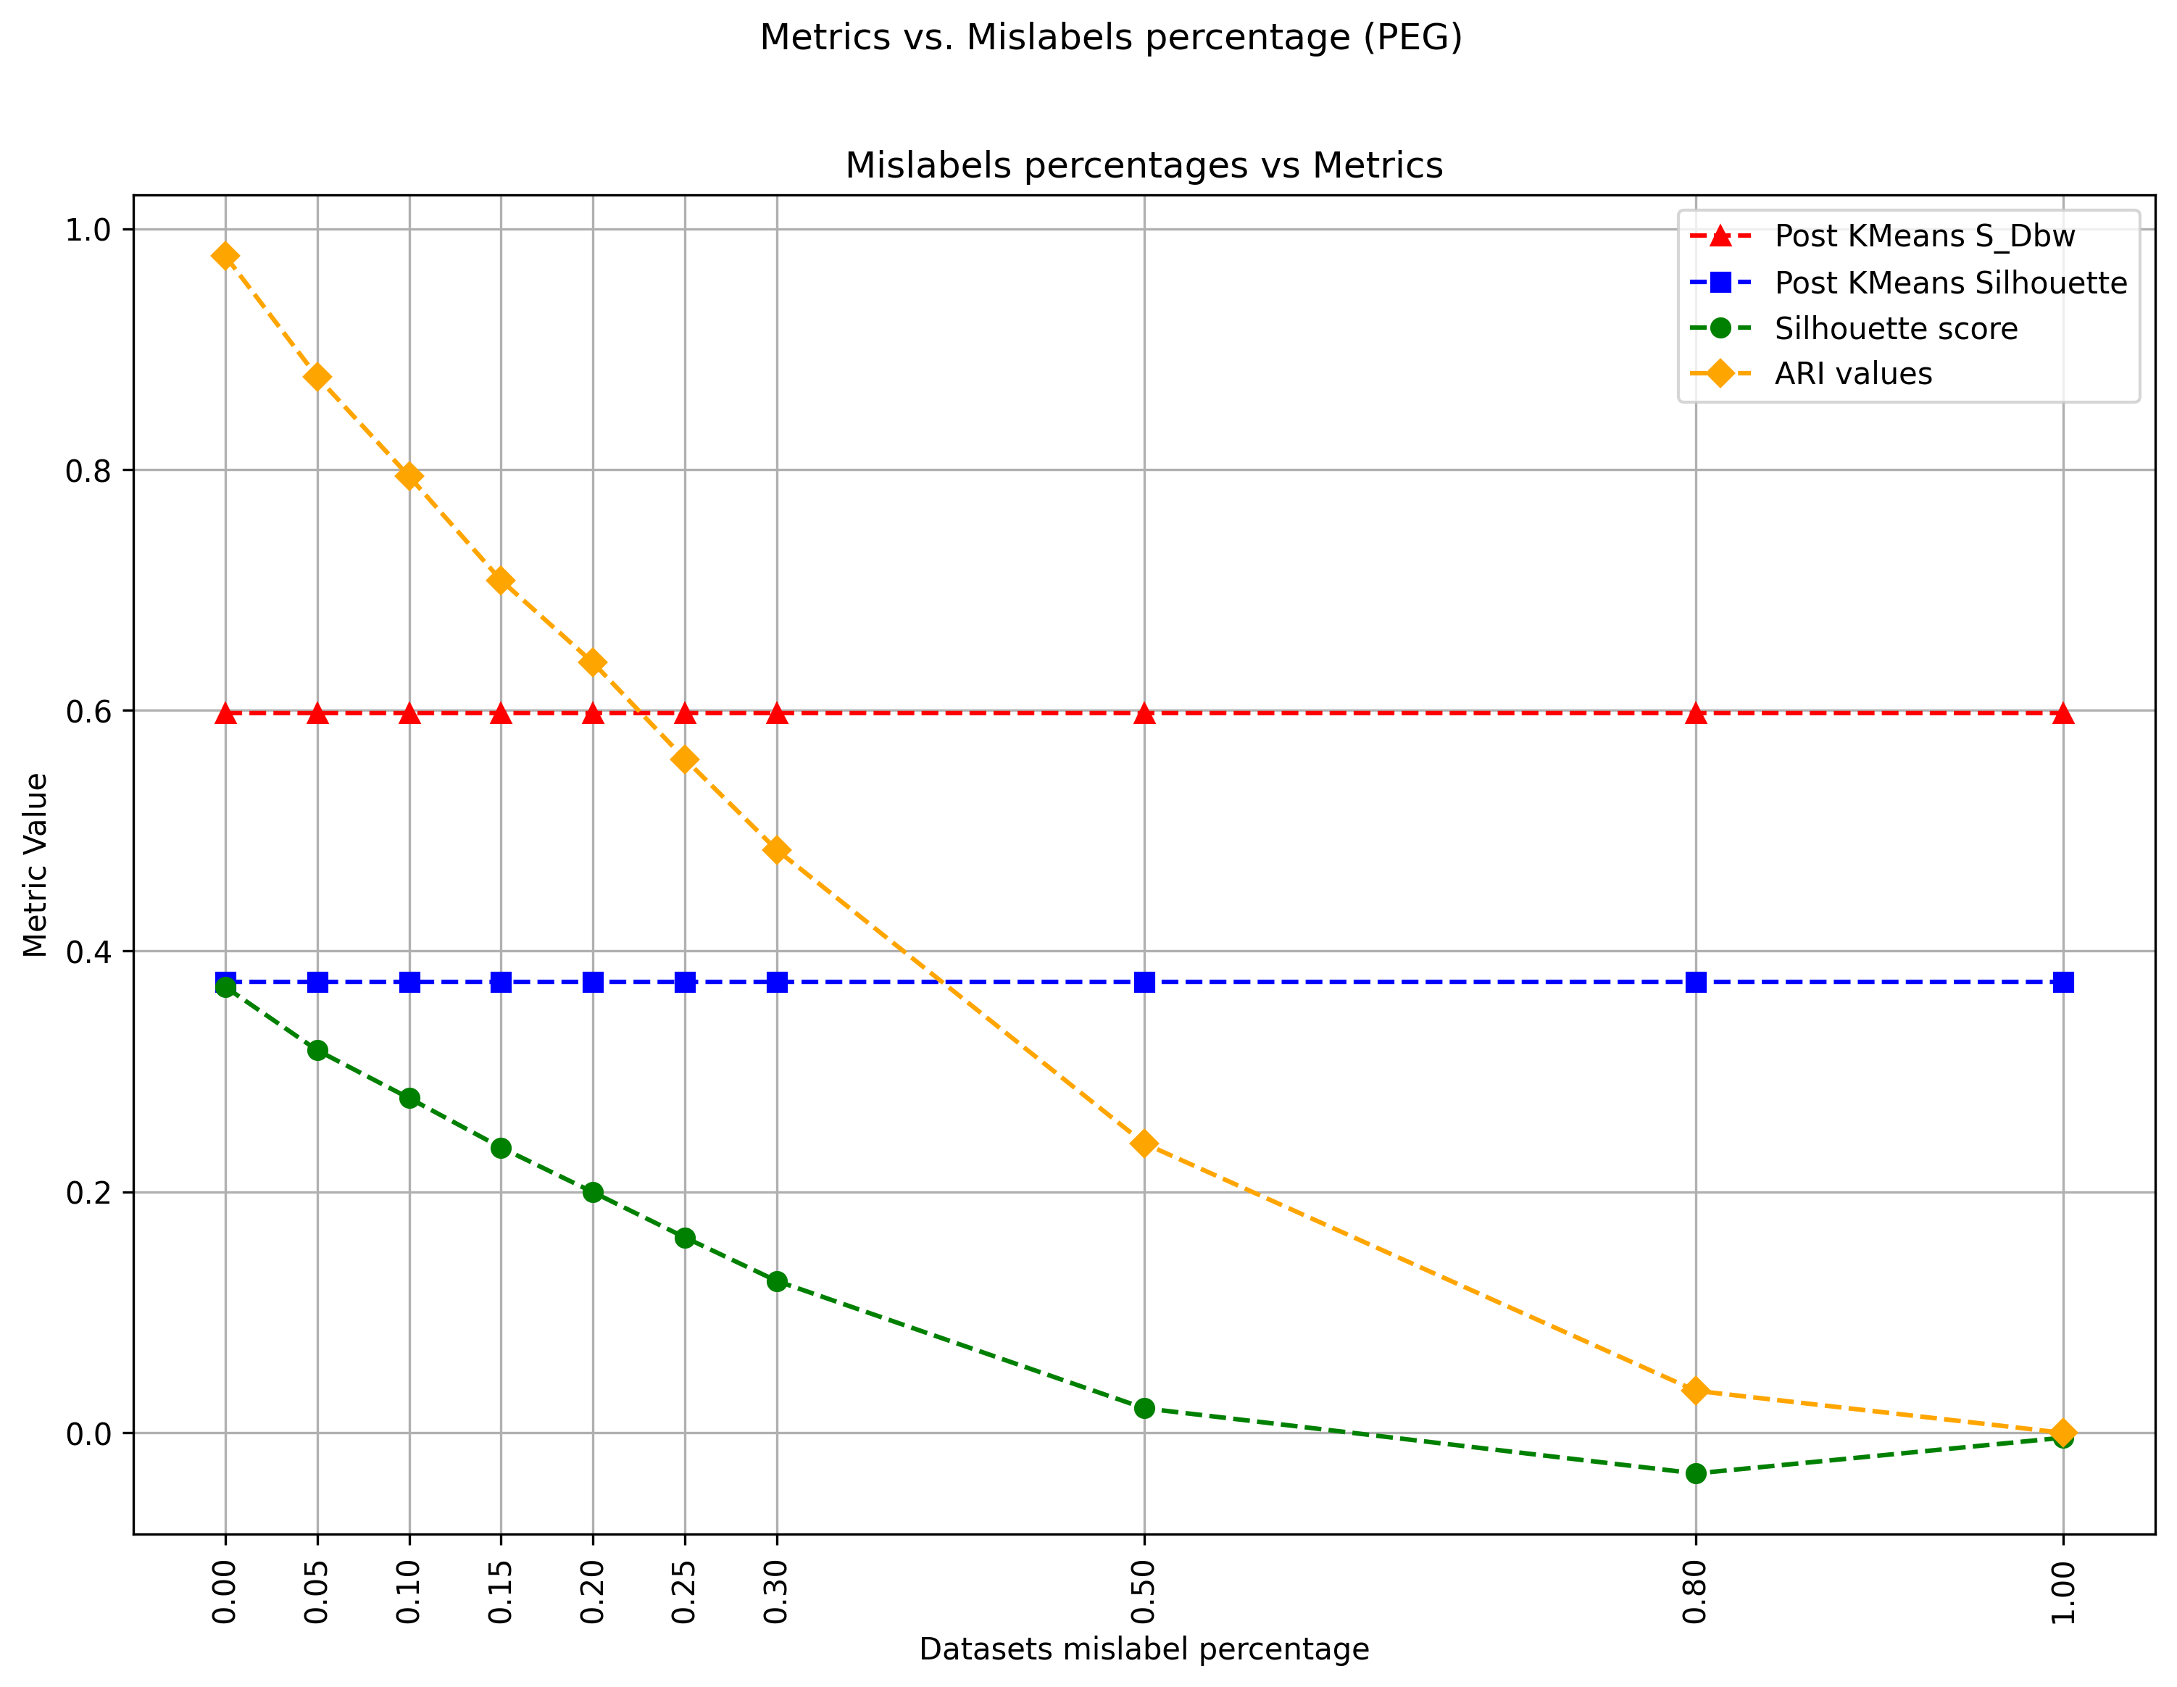
Mislabels experiment
Fig. Mislabels percentage vs Post Kmeans Metrics (Mattendichtung Dataset)
Here we can see metrics applied after performing KMeans are invariant to the mislabels
However, this will not work in cases where feature extractor cannot differentiate between two classes and assigns wrong clusters to non-mislabeled data (hard datasets)
Masterthesis discussion
15
Notes:
Ground truth labels may or may not be available in practice, here in our application we habe them available

Slide 16
Class imbalance and blur
Class imbalance was simulated on PEG, by removing some instances from NOK class. 0, 10, 20, 40, 60,80, 90 % consecutively
We also noticed the shape of the TSNE sometimes flipped or even changed minimally when data was altered
Masterthesis discussion
16
Notes:
Ground truth labels may or may not be available in practice, here in our application we habe them available

Slide 17
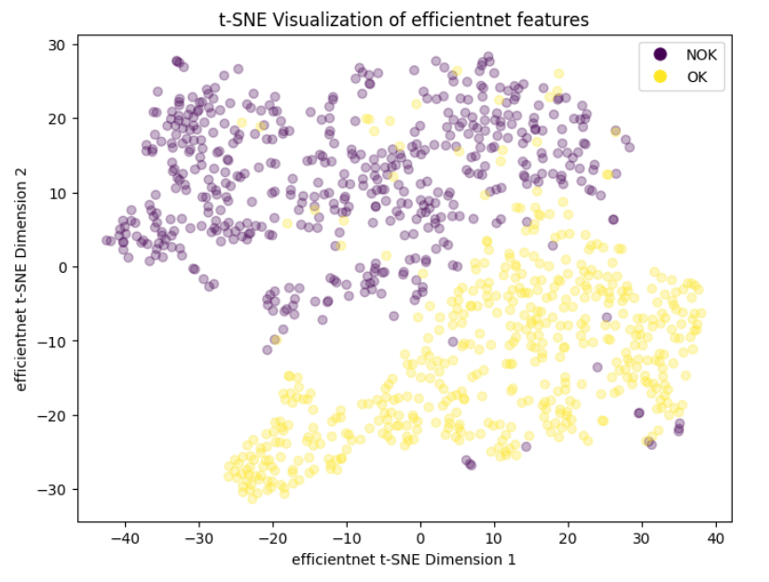
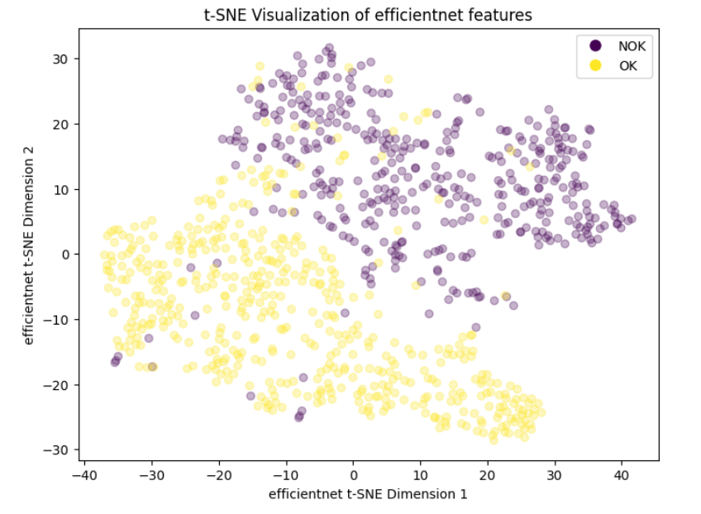
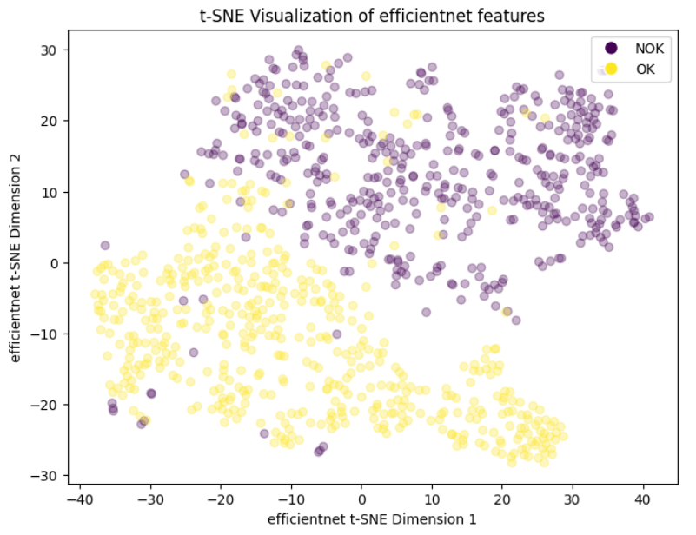
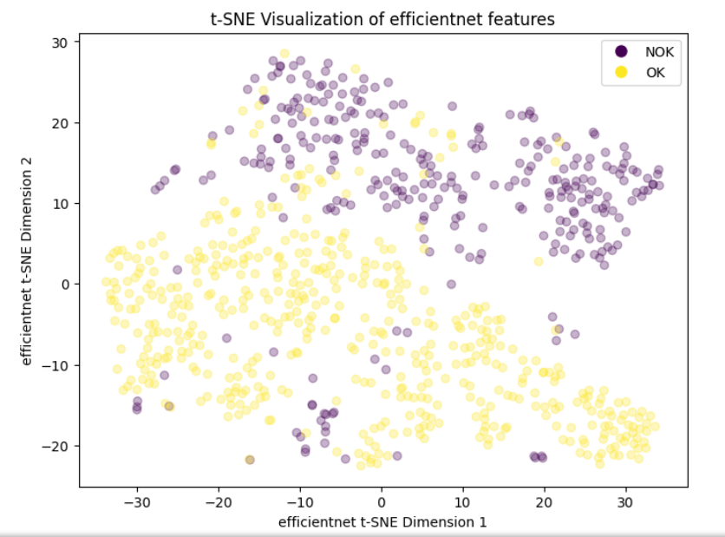
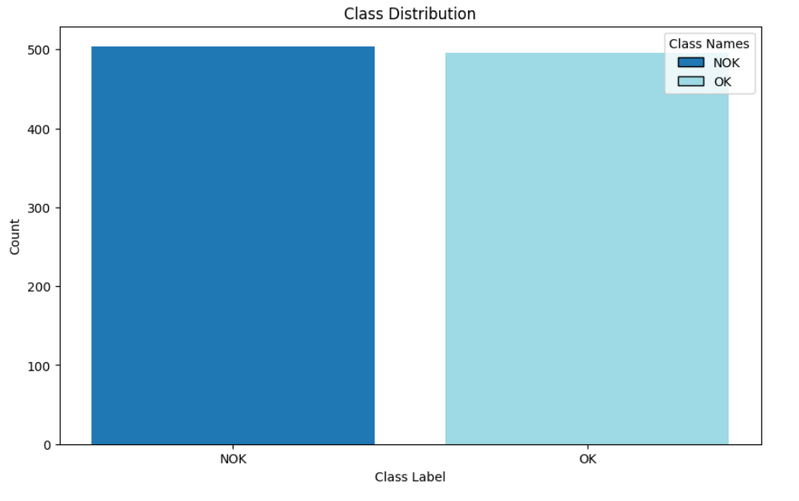
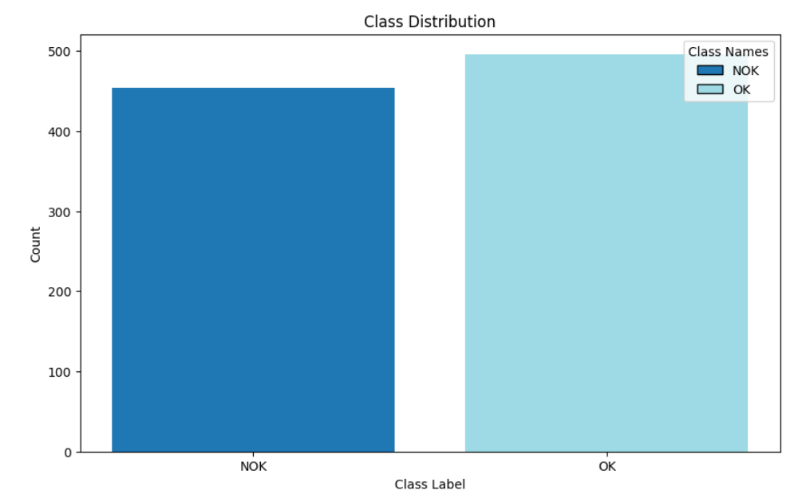
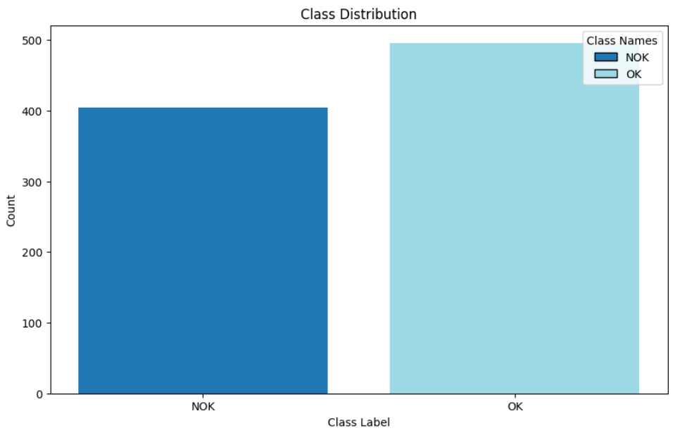
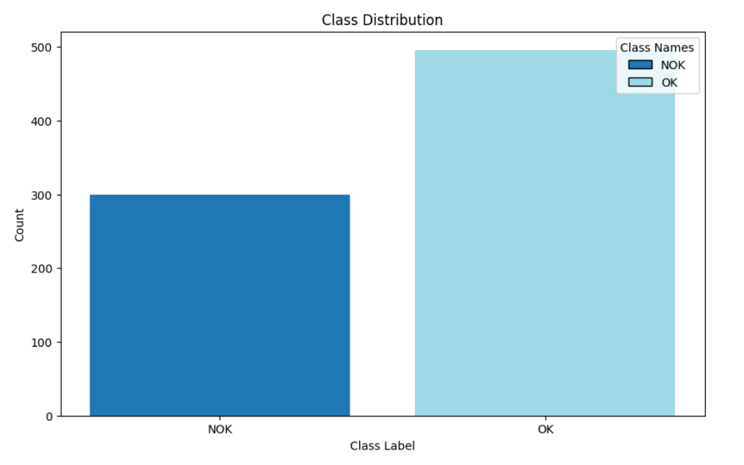
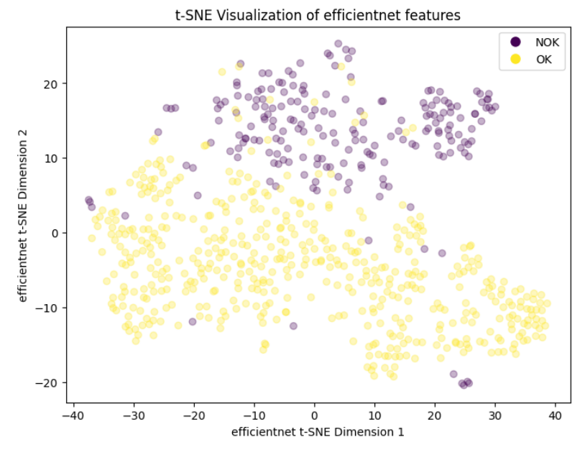
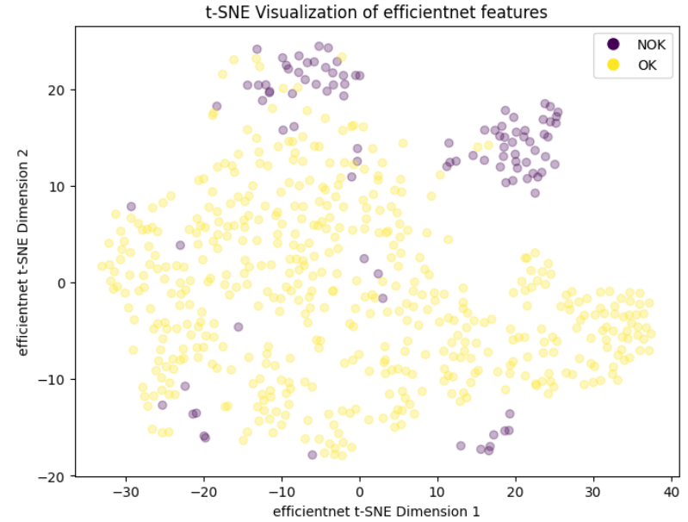
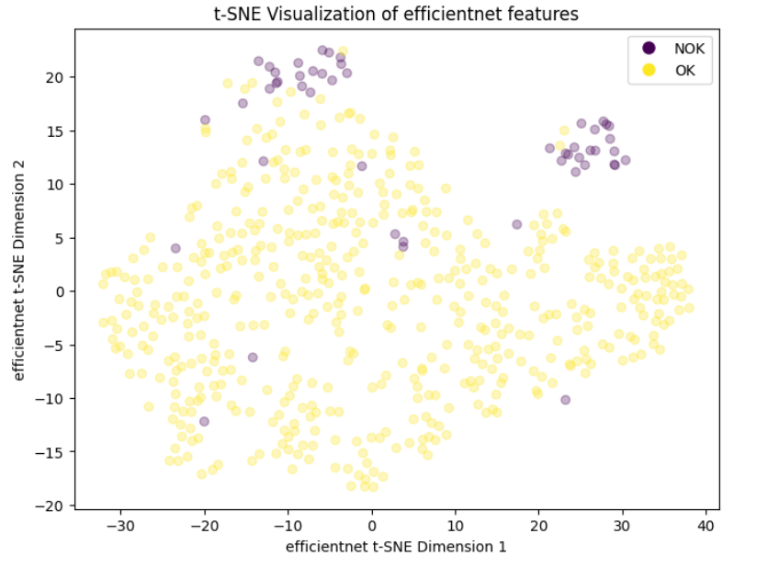
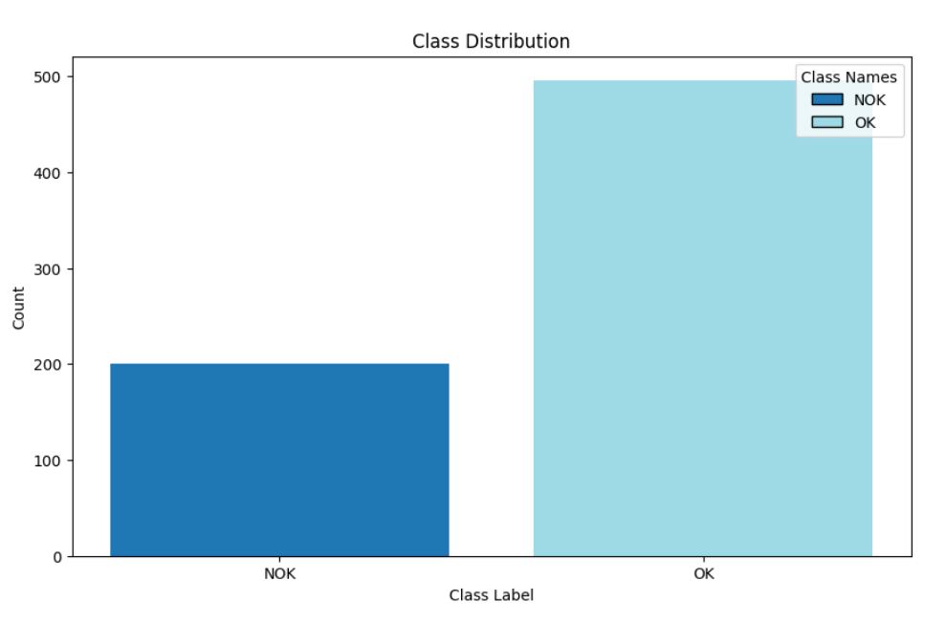
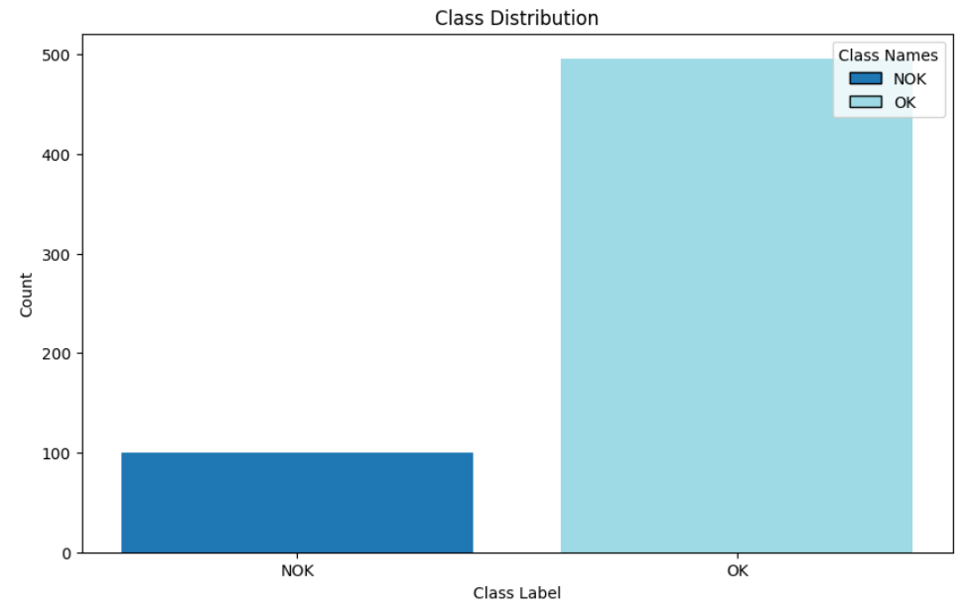
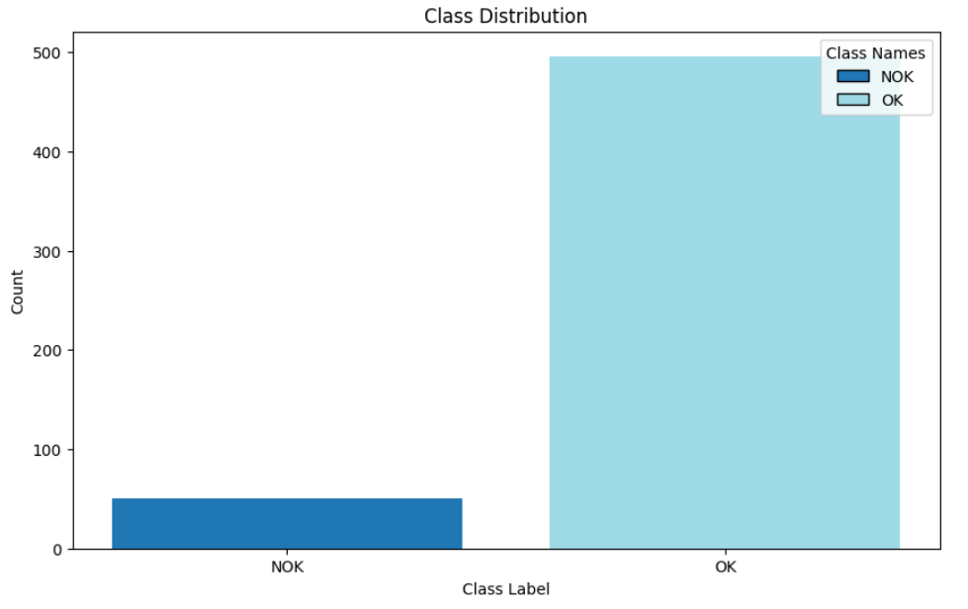
Class imbalance and blur
Class imbalance was simulated on PEG, by removing some instances from NOK class. 0, 10, 20, 40, 60,80, 90 % consecutively
Masterthesis discussion
17
Notes:
Ground truth labels may or may not be available in practice, here in our application we habe them available

Slide 18
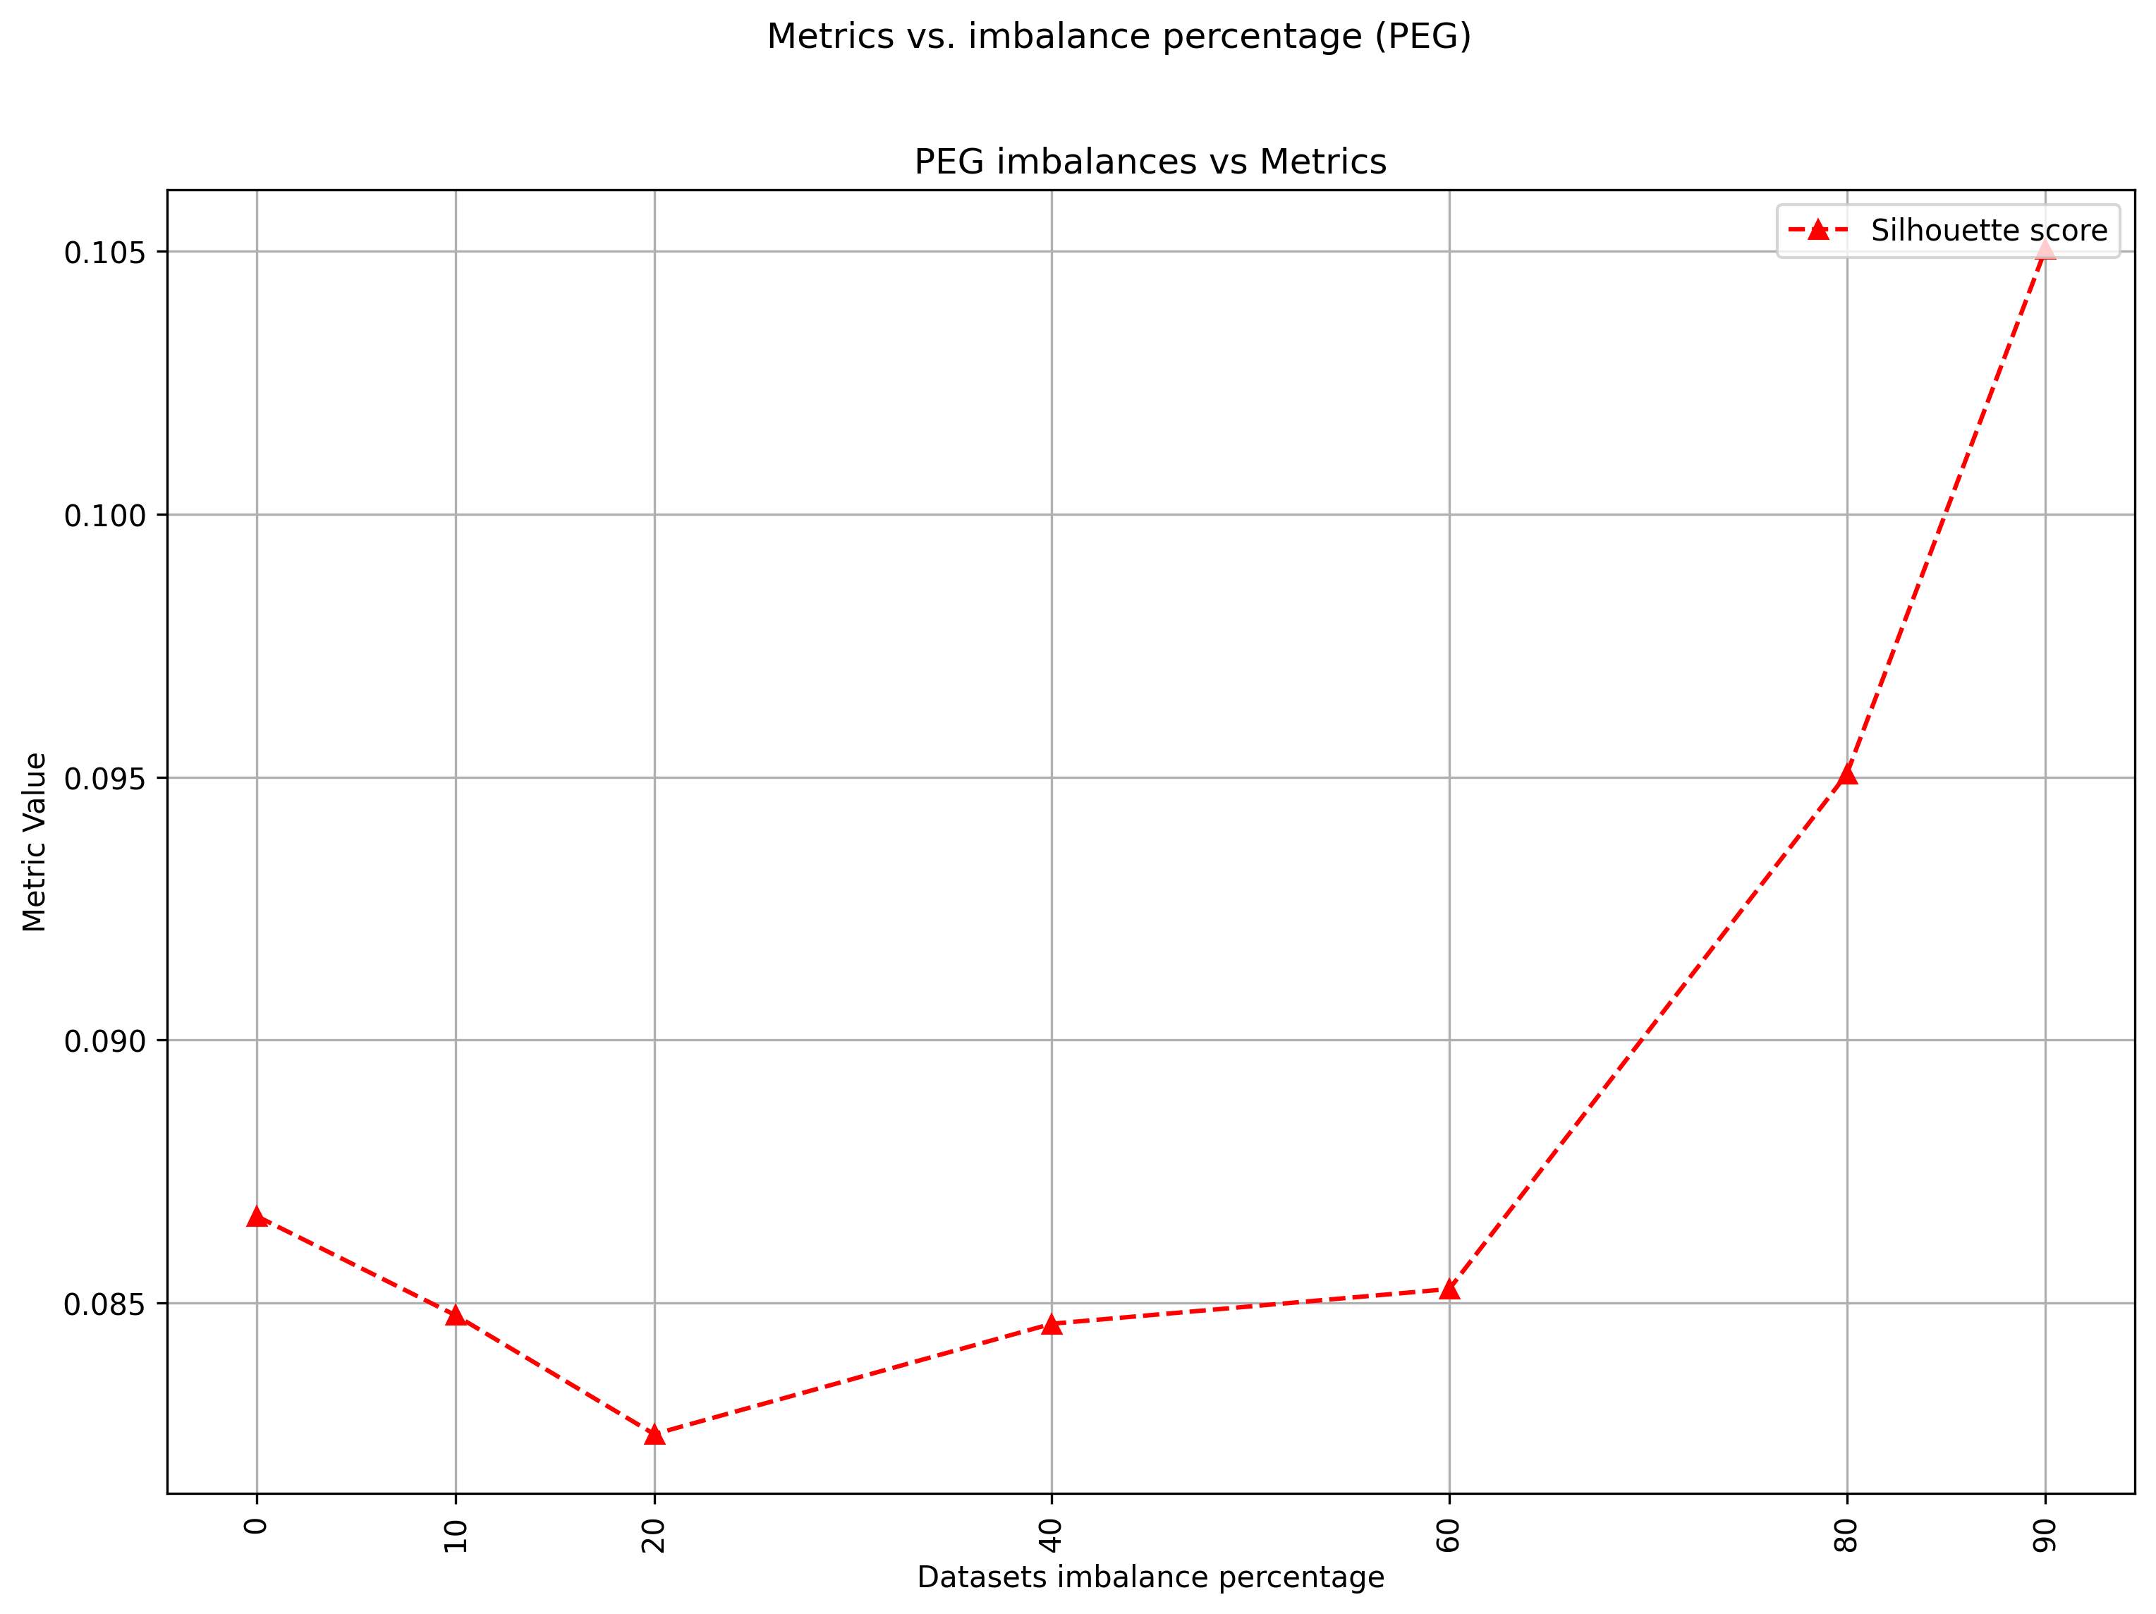
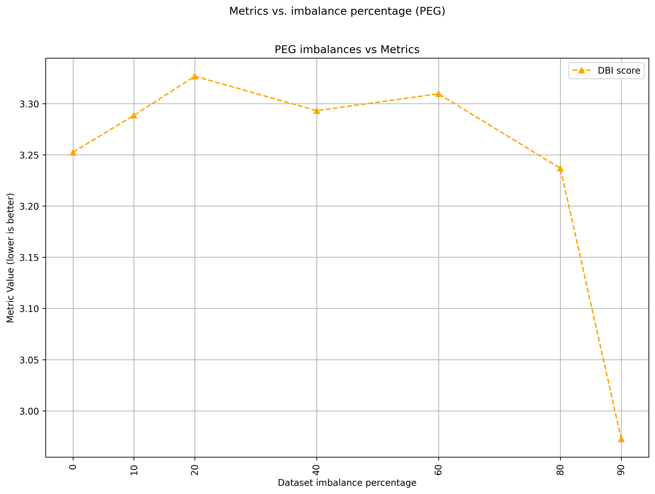
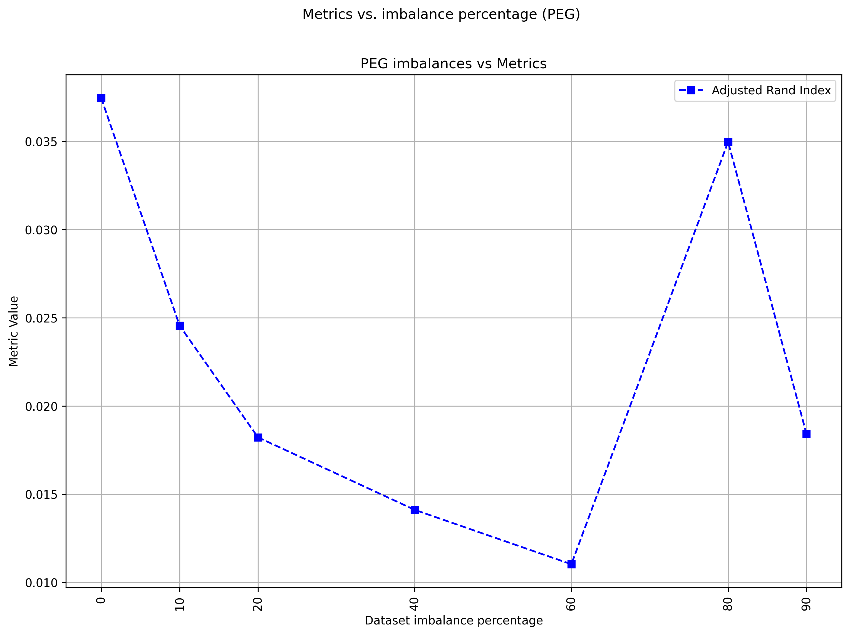
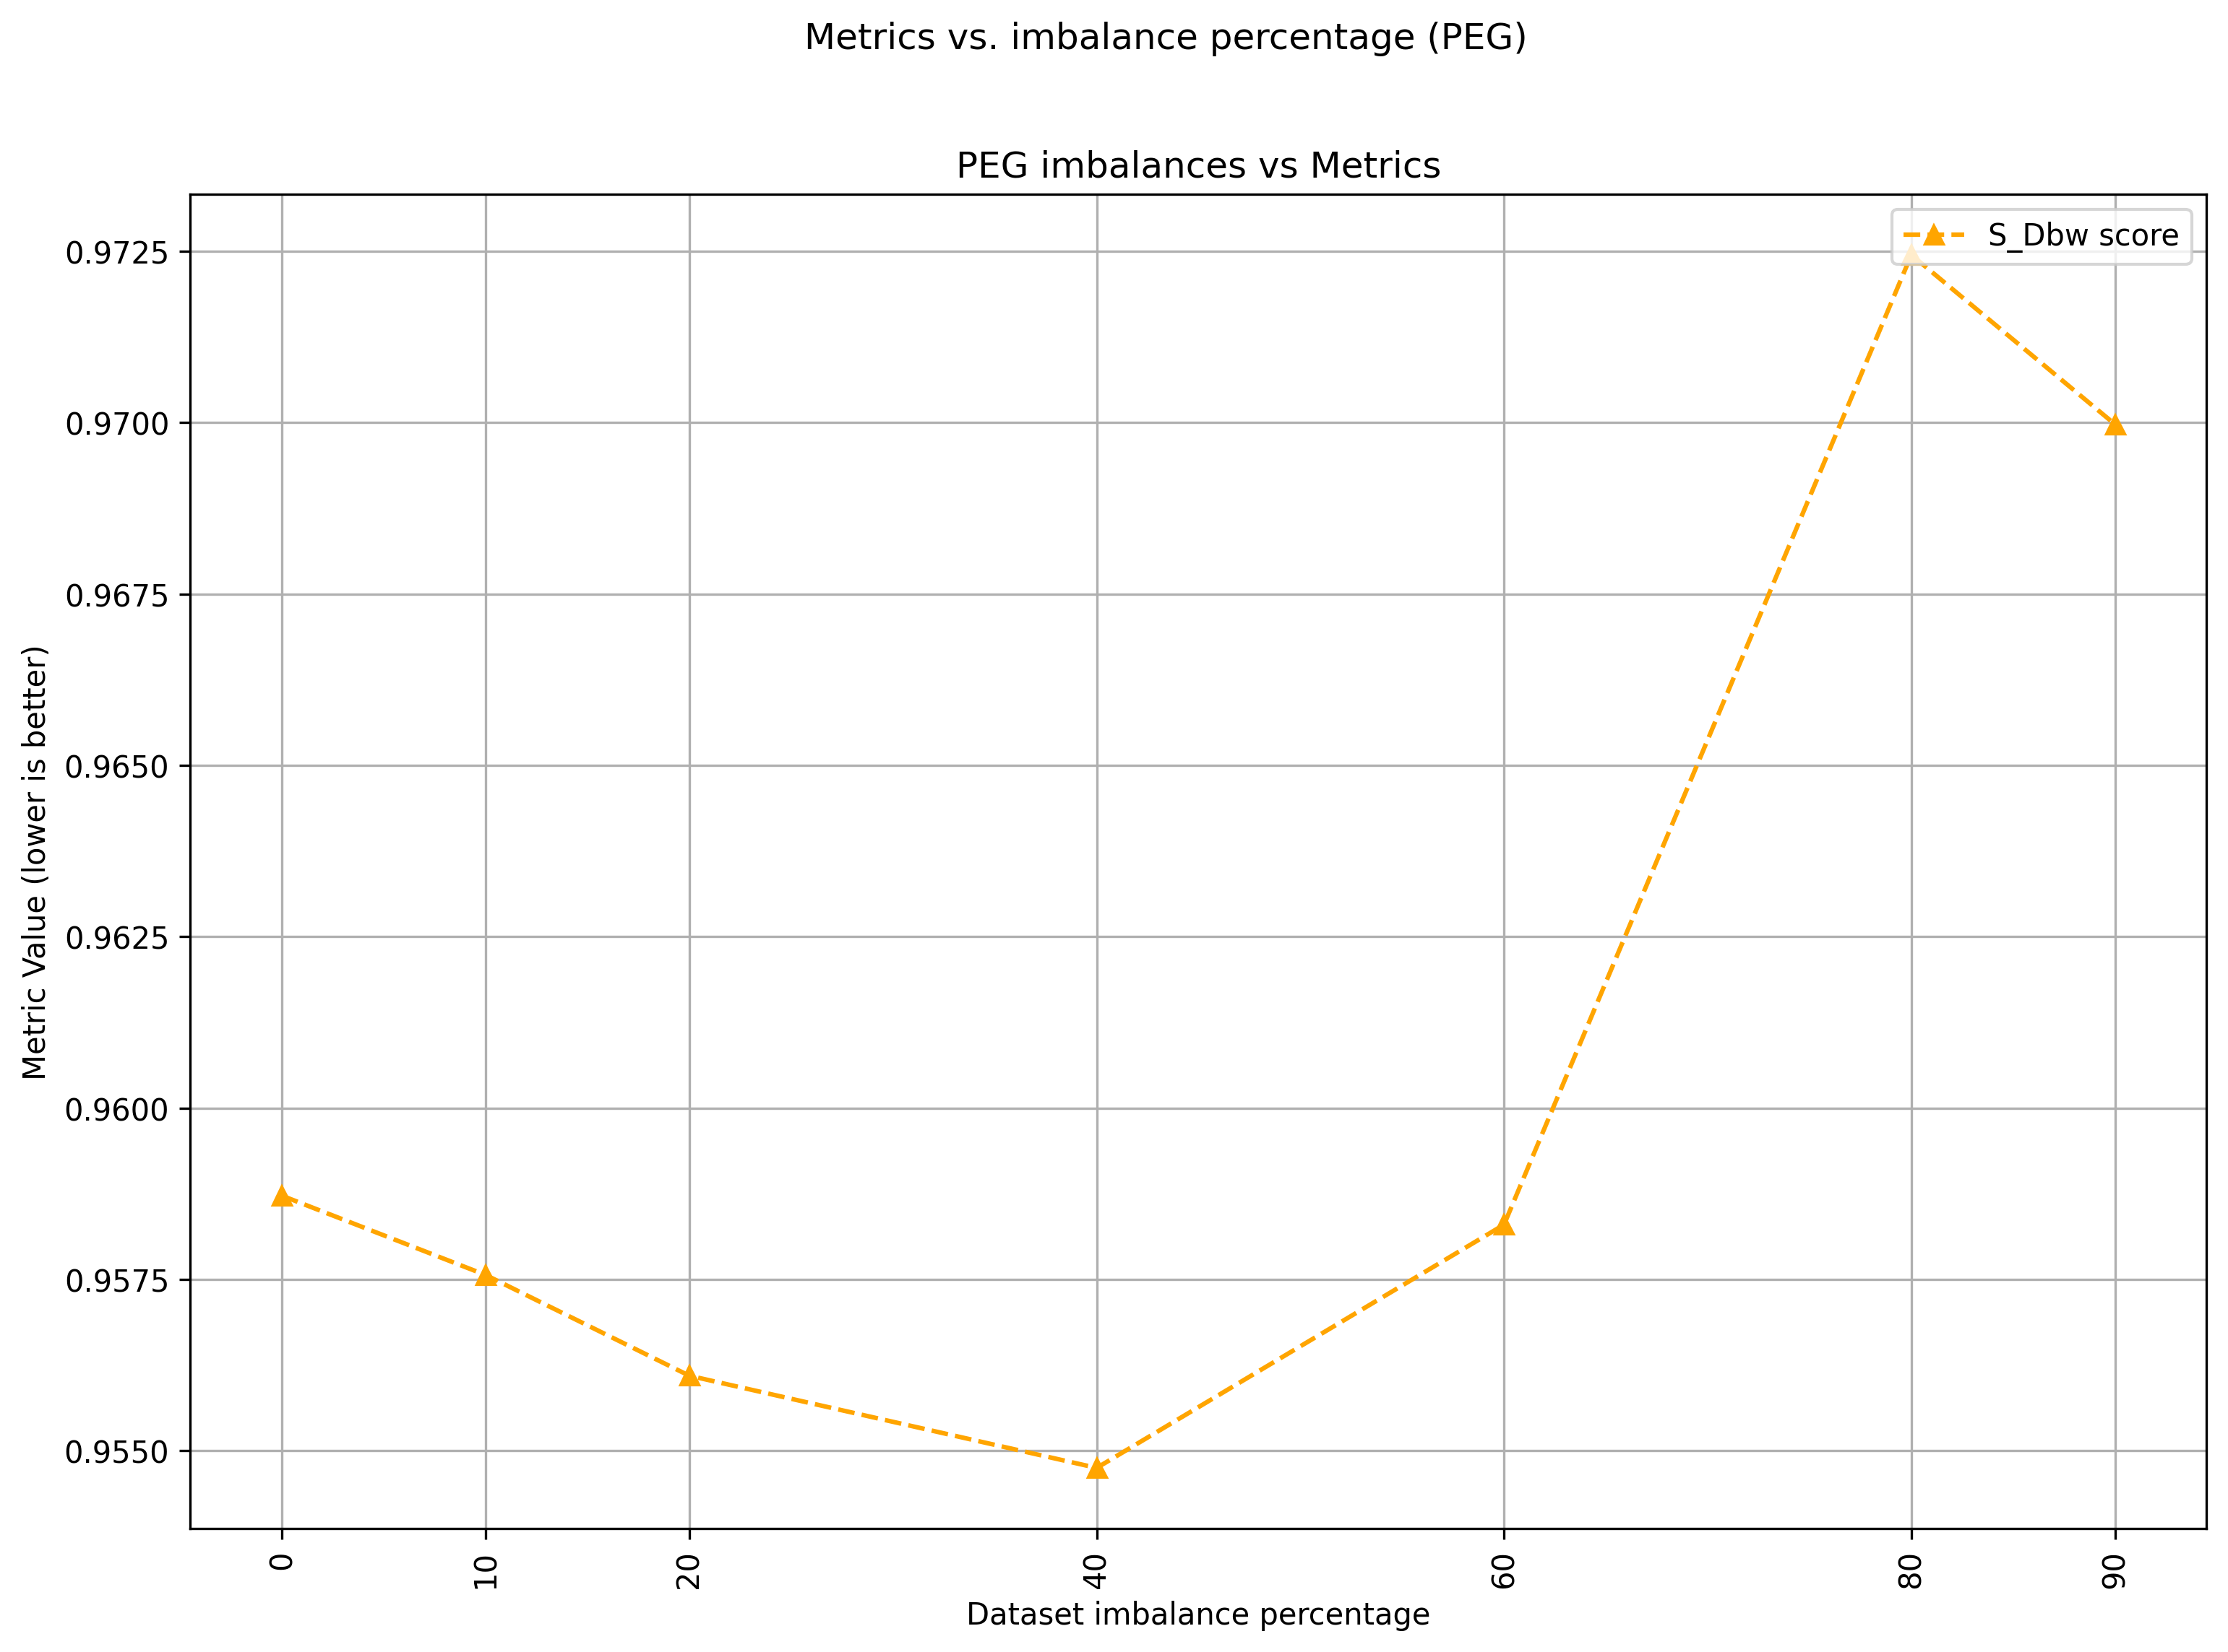
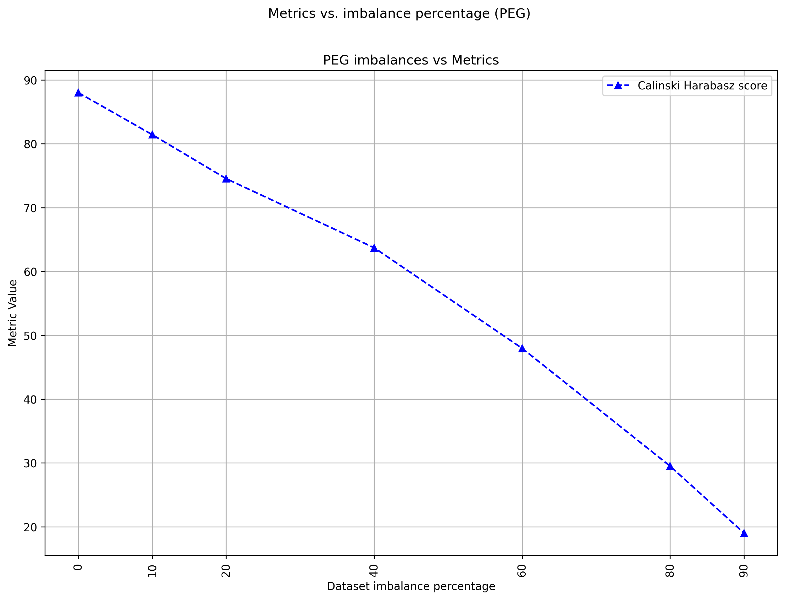
Class imbalance and blur
Metrics decreased at the start, then increased when imbalance percentage was too high
This was because the feature spaces became less overlapped due to the removal of the NOK class
Masterthesis discussion
18
Notes:
Ground truth labels may or may not be available in practice, here in our application we habe them available

Slide 20
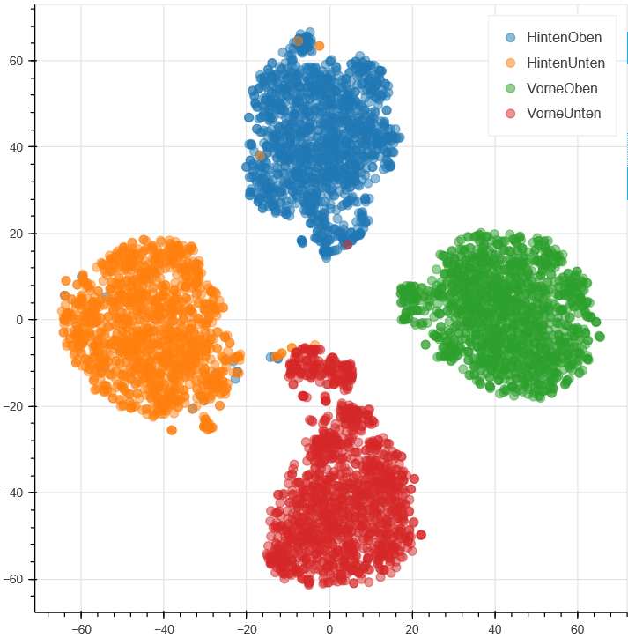
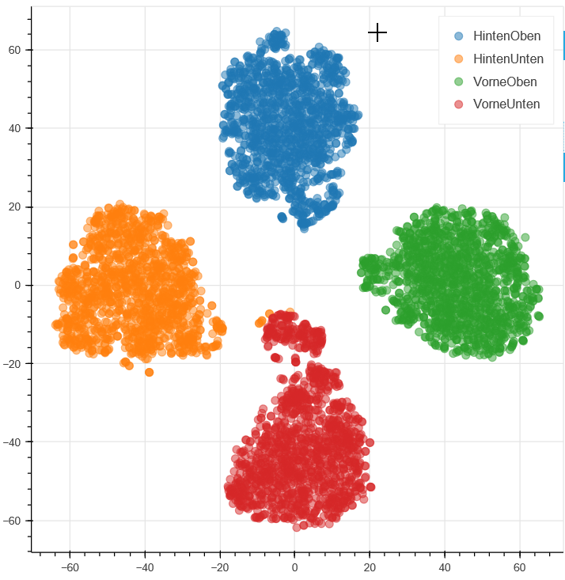
Hypothesis : Mislabels
Hypothesis : Mislabels in dataset affect our chosen metrics
How to test : Remove all mislabels and see if chosen metrics are better
Fig. Mattendichtung original (left), Mislabels removed (right)
Masterthesis discussion
20
Notes:
Ground truth labels may or may not be available in practice, here in our application we habe them available

Slide 21
Hypothesis : Mislabels metrics
Metric | High dim | Low dim
Silhouette score | 0.317 | 0.638
Davies Bouldin* | 1.402 | 0.489
Calinski Harabasz | 1910 | 13263
S_Dbw* | 0.700 | 0.350
SVM (K-Fold 10) | 99.46% | 99.54%
K-NN | 99.41% | 99.45%
Random Forest | 99.64% | 99.48%
Metric | High dim | Low dim
Silhouette score | 0.322 | 0.650
Davies Bouldin* | 1.392 | 0.478
Calinski Harabasz | 1947 | 14434
S_Dbw* | 0.695 | 0.337
SVM | 100% | 99.98%
K-NN | 99.84% | 99.86%
Random Forest | 100% | 99.93%
Fig. Mattendichtung original (left), Mislabels removed (right)
Masterthesis discussion
21
Notes:
Ground truth labels may or may not be available in practice, here in our application we habe them available

Slide 22
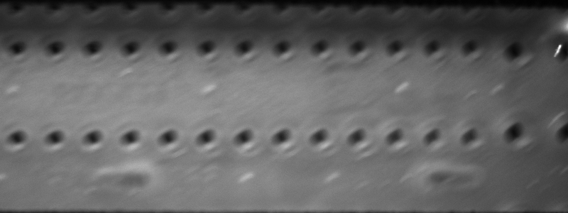
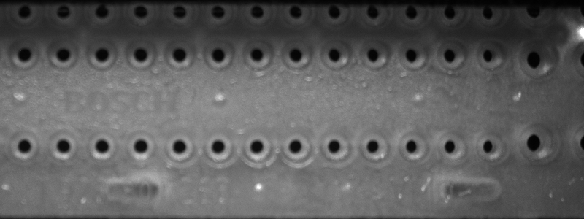
Hypothesis : Blur
Hypothesis : Blurry images = low quality features space = worse metrics
How to test : Remove blurry images using lapacian filter and a threshold then calculate feature space quality
Fig. Mattendichtung blurry (top) vs non blurry (bottom)
Masterthesis discussion
22
Notes:
Ground truth labels may or may not be available in practice, here in our application we habe them available

Slide 23
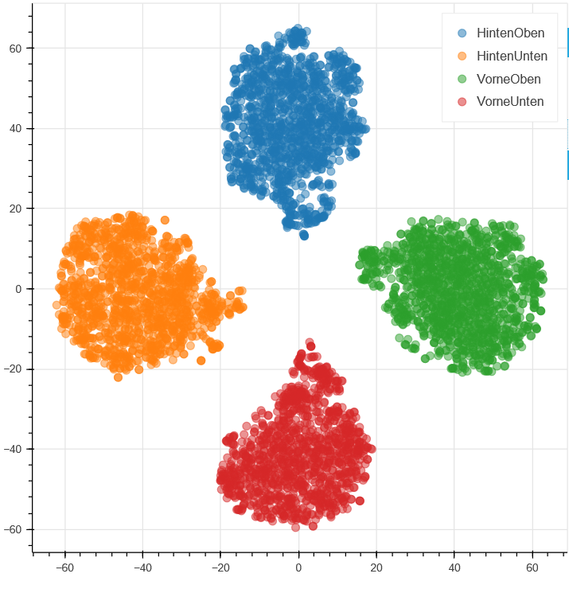
Hypothesis : Blur
Blurry images
Fig. Mattendichtung Mislabels removed (left), Blurry images removed (right)
Masterthesis discussion
23
Notes:
Ground truth labels may or may not be available in practice, here in our application we habe them available

Slide 24
Datasets overview
Fig. Mattendichtung original (left), Mislabels removed (middle), Blur removed (right)
Masterthesis discussion
24
Notes:
Ground truth labels may or may not be available in practice, here in our application we habe them available

Slide 25
Hypothesis : Blur metrics
Metric | High dim | Low dim
Silhouette score | 0.322 | 0.650
Davies Bouldin* | 1.392 | 0.478
Calinski Harabasz | 1947 | 14434
S_Dbw* | 0.695 | 0.337
SVM | 100% | 99.98%
K-NN | 99.84% | 99.86%
Random Forest | 100% | 99.93%
Metric | High dim | Low dim
Silhouette score | 0.332 | 0.660
Davies Bouldin* | 1.295 | 0.460
Calinski Harabasz | 2124 | 14976
S_Dbw* | 0.677 | 0.327
SVM | 100% | 100%
K-NN | 99.96% | 100%
Random Forest | 100% | 100%
Fig. Mattendichtung Mislabels removed (left), Blurry removed (right)
Masterthesis discussion
25
Notes:
Ground truth labels may or may not be available in practice, here in our application we habe them available

Slide 26
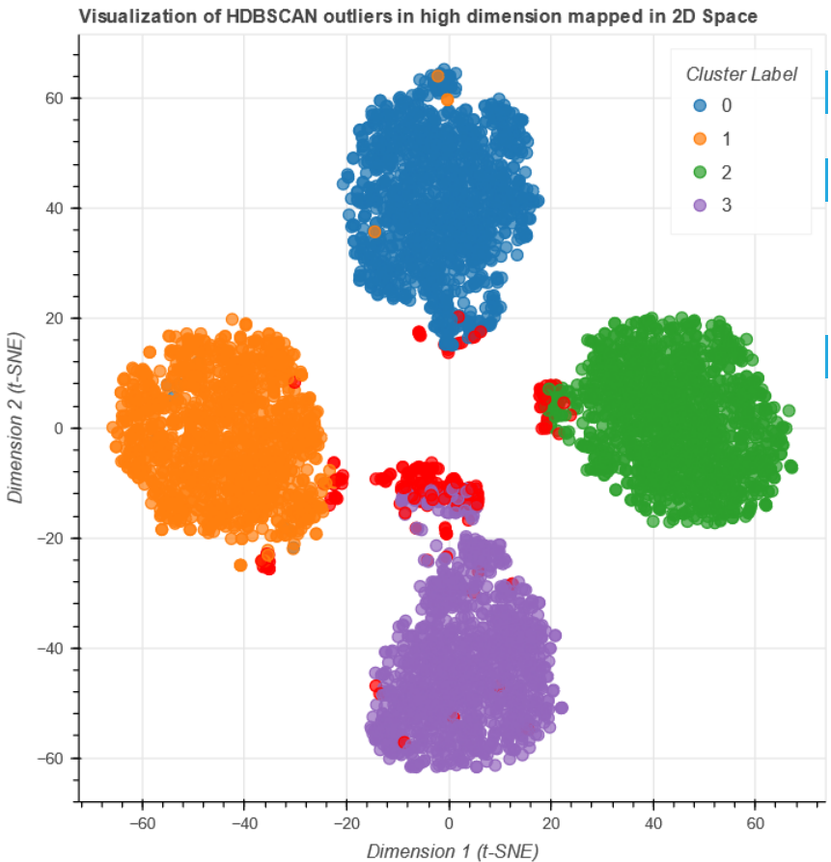
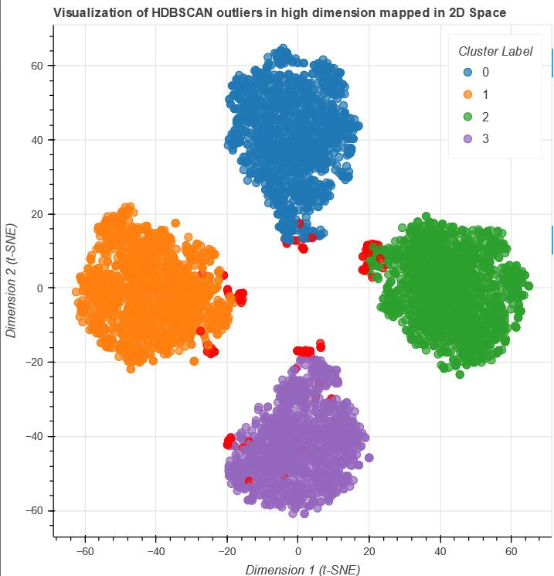
Outliers
High dim outliers: 214
Low dim outliers: 8
High dim outliers: 120
Low dim outliers: 0
Fig. Mattendichtung original (left), Blur removed (right)
Masterthesis discussion
26
Notes:
Ground truth labels may or may not be available in practice, here in our application we habe them available

Slide 27
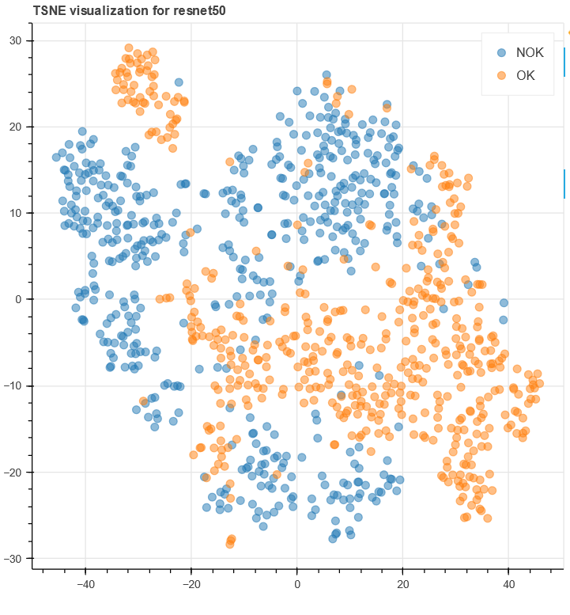
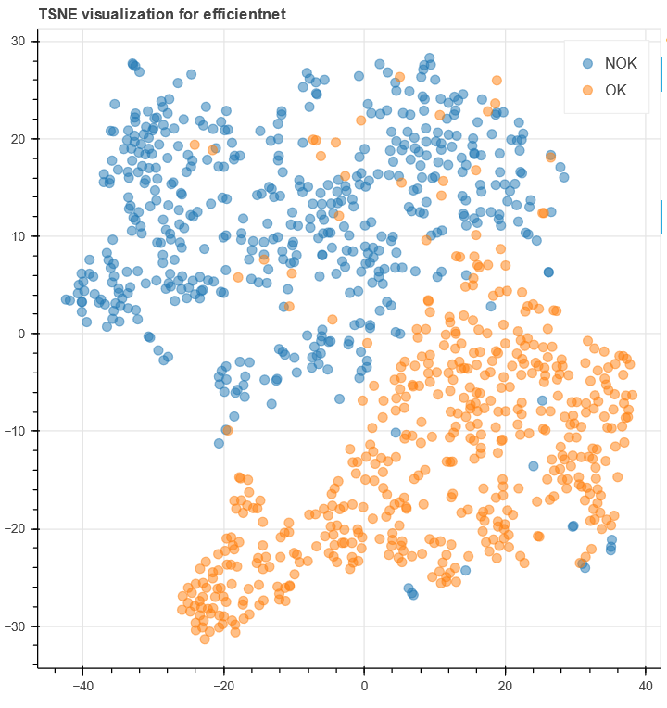
PEG Metrics
Metric | High dim | Low dim
Silhouette score | 0.053 | 0.133
Davies Bouldin* | 4.217 | 2.236
Calinski Harabasz | 53.84 | 166.655
S_Dbw* | 0.974 | 0.926
SVM | 97.40% | 69.70%
K-NN | 92.00% | 92.20%
Random Forest | 95.50% | 92.60%
Metric | High dim | Low dim
Silhouette score | 0.087 | 0.318
Davies Bouldin* | 3.253 | 1.281
Calinski Harabasz | 88.029 | 490.307
S_Dbw* | 0.959 | 1.819
SVM | 98.40% | 93.60%
K-NN | 93.70% | 94.40%
Random Forest | 95.50% | 95.20%
Fig. PEG Resnet (left), PEG Efficientnet (right)
Masterthesis discussion
27
Notes:
Ground truth labels may or may not be available in practice, here in our application we habe them available

Slide 28
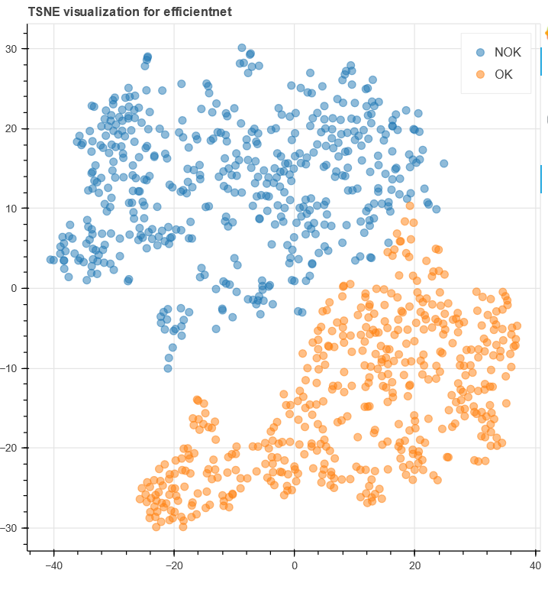
PEG outliers removed metrics
Metric | High dim | Low dim
Silhouette score | 0.087 | 0.318
Davies Bouldin* | 3.253 | 1.281
Calinski Harabasz | 88.029 | 490.307
S_Dbw* | 0.959 | 1.819
SVM | 98.40% | 93.60%
K-NN | 93.70% | 94.40%
Random Forest | 95.50% | 95.20%
Metric | High dim | Low dim
Silhouette score | 0.1 | 0.407
Davies Bouldin* | 2.979 | 1.040
Calinski Harabasz | 99.76 | 726.384
S_Dbw* | 0.952 | 0.753
SVM | 99.26% | 98.05%
K-NN | 96.42% | 99.37%
Random Forest | 97.37% | 99.26%
Fig. PEG Efficientnet (left), PEG No outliers Efficientnet (right)
Masterthesis discussion
28
Notes:
Ground truth labels may or may not be available in practice, here in our application we habe them available

Slide 29
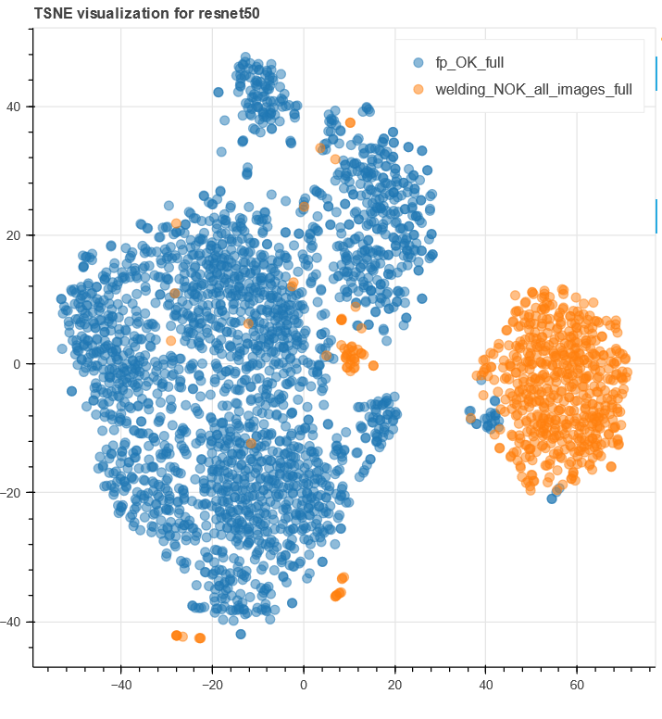
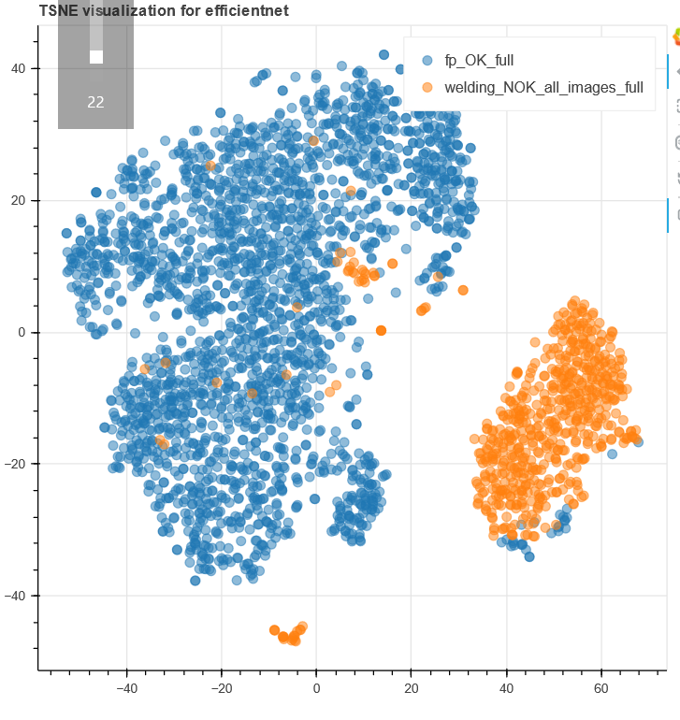
ASQMM
Metric | High dim
# Outliers LOF | 25
Silhouette score | 0.402
Davies Bouldin* | 1.114
Calinski Harabasz | 1593.998
S_Dbw* | 0.893
SVM | 99.42%
K-NN | 96.91%
Random Forest | 98.22%
Neural network | 98.90%
Metric | High dim
# Outliers LOF | 23
Silhouette score | 0.416
Davies Bouldin* | 1.049
Calinski Harabasz | 1756.474
S_Dbw* | 0.857
SVM | 99.18%
K-NN | 96.95%
Random Forest | 97.63%
Nerual network | 99.18%
Fig. ASQMM ResNet (left), ASQMM Efficientnet (right)
Masterthesis discussion
29
Notes:
Ground truth labels may or may not be available in practice, here in our application we habe them available

Slide 30
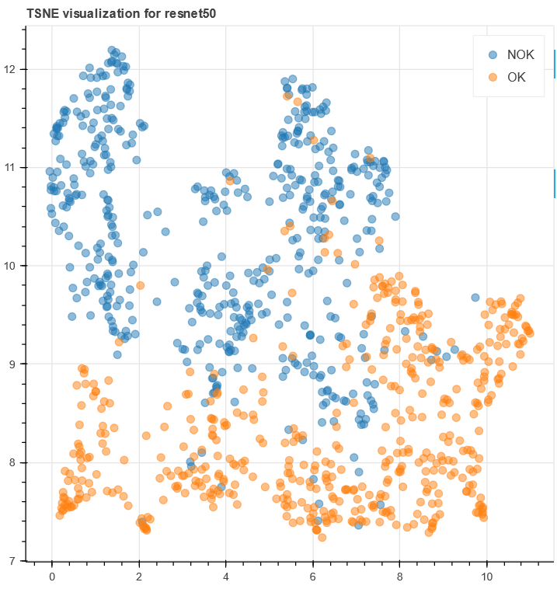
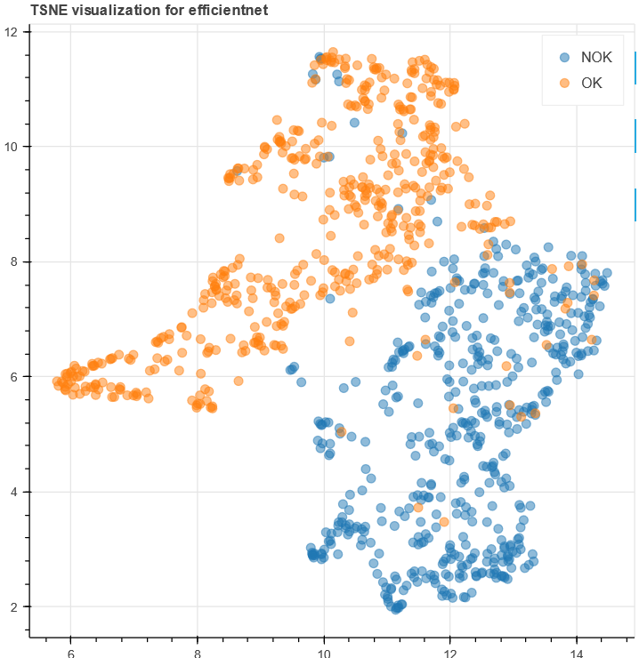
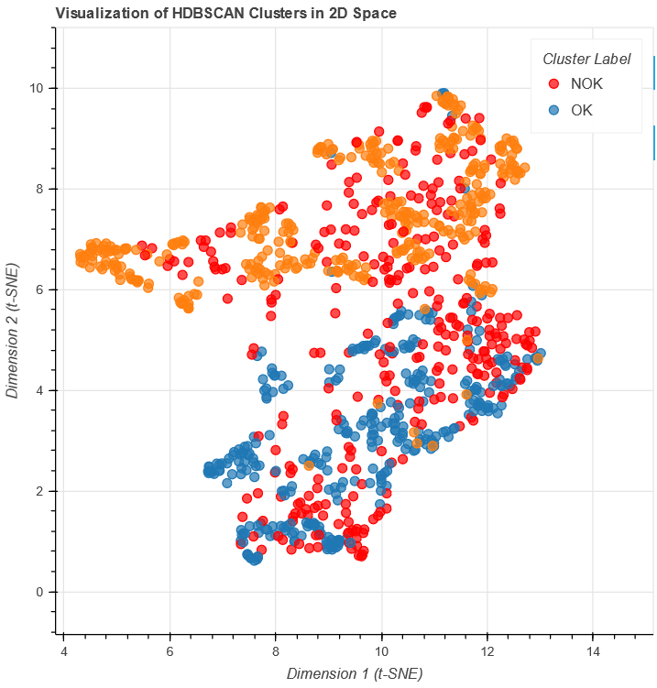
Questions
What are some common effects seen in real world data and clusterings?
How to exaggerate effects in high dimensions? To see the how the metrics are sensitive to it, ex : class overlap
Fig. PEG Resnet(left), PEG Efficientnet (middle), PEG Efficientnet outliers in high dim using HDBSCAN(right)
Masterthesis discussion
30
Notes:
Ground truth labels may or may not be available in practice, here in our application we habe them available

Slide 31
Percentage changes in metrics (high dimension)
Metric | % Changes
Silhouette score | 1.57%
Davies Bouldin* | 0.71%
Calinski Harabasz | 1.93%
S_Dbw* | 0.71%
Metric | % Changes
Silhouette score | 3.10%
Davies Bouldin* | 6.96%
Calinski Harabasz | 9.09%
S_Dbw* | 2.65%
Fig. % changes when mislabels removed
Fig. % changes when blur + mislabels removed
Calinski Harabasz is very sensitive to tweaks in dataset, can be used when we want to see effect of small pertubations.
But it doesnt perform well on different types of synthetic datasets as seen [ref]
Overall DB and Silhouette score had the best performances on 11/13 datasets in the same study
Masterthesis discussion
31
Notes:
Ground truth labels may or may not be available in practice, here in our application we habe them available

Slide 32
What literature says
But, “Davies-Bouldin is not robust to distinguish among poor quality partitions and, as such not recommended for tight real-world application scenarios involving complicative factors like noise contamination, cluster overlapping, high dimensionality, among others.” [ref2]
Same study showed Silhouette to be better than Davies Bouldin and Dunn index
Most studies conducted on relatively low dimensions, compared to our work
Clustering measures like DB, CH, Silhouette measures have a strong bias towards spherical and hyperspherical clusterings [ref3] [ref2]
DBSCAN detects noise, but this noise may not be true noise, and most algorithms don’t take noise into consideration [ref3]
Masterthesis discussion
32
Notes:
Ground truth labels may or may not be available in practice, here in our application we habe them available

Slide 33
What literature says
DBCV is a recent (2014) density based measure, which does take noise into account, it also has a range, like silhouette, making it easier to interpret
However, “DBCV can be useful for data sets with well separated structure, but the results become less interesting as data becomes more noisy or transitions between clusters become more blurred.”
“From a high score on an external measure we can conclude that the algorithm has successfully recovered the already known structure, but from a low score we cannot conclude that the produced clustering is bad.” [ref3]
Highly imbalanced clusterings score well (separating few points from others)
Masterthesis discussion
33
Notes:
Ground truth labels may or may not be available in practice, here in our application we habe them available

Slide 34
Currently working on
Using external measures (ARI, NMI and AMI and others)
Implement FERM and DBCV
Using Dense layer as classifier
Trying to recreate study findings in our datasets / more datasets
Masterthesis discussion
34
Notes:
Ground truth labels may or may not be available in practice, here in our application we habe them available

Slide 35
The end

Slide 36






Datasets overview
7 Datasets in total
Using purely industrial datasets for now
2 from Bosch and other 5 from MVTechAD
Multi class and binary
„Easy“ and „Hard“ datasets
Fig. Random samples of faulty (left) vs OK (right)
Masterthesis discussion
36
Notes:
Ground truth labels may or may not be available in practice, here in our application we habe them available

Slide 37









Dataset samples
Fig. Good, Contamination, Broken_large, Broken_small (left to right)
Fig. Good, poke, print error, scratch, squeeze (left to right)
Masterthesis discussion
37
Notes:
Ground truth labels may or may not be available in practice, here in our application we habe them available

Slide 38



Dataset distributions
Fig. Mattendichtung, MVTecAD Screw and PEG class distibutions (left to right)
Masterthesis discussion
38
Notes:
Ground truth labels may or may not be available in practice, here in our application we habe them available

Slide 39
Table of choices
Metrics | Feature extractors | ML models | Datasets
% or # Outliers Davies Bouldin Silhouette score Calinski Harabasz S_Dbw FERM1 FERM2 DBCV Dunn Index Purity score Composite metric | ResNet50 VGG19 EfficientNet0 CLIP/ ViT VAE | SVM K-NN Random Forest Need more? | Mattendichtung PEG Screw Metal nut Cable Capsule Bottle Others/TBD
Fig. Table of experiment parameters
Masterthesis discussion
39
Notes:
Ground truth labels may or may not be available in practice, here in our application we habe them available

Slide 40
Implementation notes
Creating a framework/library for conducting experiments (DatasetWiz)
Pipeline with data loading, dataset and feature space visualization, model evaluation and metrics
Will be reused as visualization tool for Uni requirements
Plug and play metrics, datasets, feature extractors
Final goal : one click execution and calculation for all „parameters“ with output generation
Masterthesis discussion
40
Notes:
Ground truth labels may or may not be available in practice, here in our application we habe them available

Slide 41
Results demo
Masterthesis discussion
41
Notes:
Ground truth labels may or may not be available in practice, here in our application we habe them available

Slide 42
Results discussion
Mattendichtung is easiest to classify, maybe thats why metrics dont correspond to ML results
Margins/differences between ML metrics are really low, how to evaluate feature space metrics properly? Epochs?
VGG has best metrics (in Mattendichtung) but worst results
Efficient net overall best feature extractor
Masterthesis discussion
42
Notes:
Ground truth labels may or may not be available in practice, here in our application we habe them available

Slide 43
TODOs
Implement confidence intervals and some kind of repeatability structure (seeds?)
Implement remaining metrics
Implement CLIP (text?), and VAE
Any recommended TODOs?
Masterthesis discussion
43
Notes:
Ground truth labels may or may not be available in practice, here in our application we habe them available

Slide 44
Questions and discussion
How can we use extrinsic metric to evaluate a featue space? Wouldnt we end up evaluating the clustering method
Feedback?
Masterthesis discussion
44
Notes:
Ground truth labels may or may not be available in practice, here in our application we habe them available

Slide 45
The End
Thank you for your attention!
Masterthesis discussion
45
Notes:
Ground truth labels may or may not be available in practice, here in our application we habe them available

Slide 46
End of slides
Masterthesis discussion
46
Notes:
Ground truth labels may or may not be available in practice, here in our application we habe them available

Slide 47

Methodology
fig. Methodology overview
Masterthesis discussion
47
Notes:
Ground truth labels may or may not be available in practice, here in our application we habe them available

Slide 48
Test experiment
2 feature extractors : VGG19 and ResNet50 (both pretrained on ImageNet)
2 Datasets : Mattendichtung and PEG
5 intrinsic metrics used for now until others are implemented
3 ML models used SVM, KNN and Random Forest
Throwaway code
Metrics calulated on high as well as low dimensions
Models trained on high dimensions
Masterthesis discussion
48
Notes:
Ground truth labels may or may not be available in practice, here in our application we habe them available

Slide 49


Visualization Mattendichtung
Masterthesis discussion
49
Notes:
Ground truth labels may or may not be available in practice, here in our application we habe them available

Slide 50
Mattendichtung results
Intrinsic metric | ResNet TSNE | ResNet High dim | VGG19 TSNE | VGG19 high dim
Num Outliers* | 9 | 14 | 47 | 7
Silhouette | 0.587 | 0.347 | 0.607 | 0.427
Davies- Bouldin index* | 0.506 | 1.307 | 0.474 | 0.954
Calinski Harabasz | 7650.95 | 1908.03 | 7920.00 | 2412.16
S_Dbw* | 0.387 | 0.685 | 0.322 | 0.632
Model | Random Forest F1 score | SVM F1 score | K-NN F1 score
ResNet 50 | 0.9955 | 0.9933 | 0.9944
VGG 19 | 0.9955 | 0.9955 | 0.9966
Fig. Mattendichtung dataset results ( * means lower is better)
Masterthesis discussion
50
Notes:
Ground truth labels may or may not be available in practice, here in our application we habe them available

Slide 51


Visualization PEG
Masterthesis discussion
51
Notes:
Ground truth labels may or may not be available in practice, here in our application we habe them available

Slide 52
PEG results
Intrinsic metric | ResNet TSNE | ResNet High dim | VGG19 TSNE | VGG19 high dim
Num Outliers* | 0 | 0 | 4 | 0
Silhouette | 0.2352 | 0.068 | 0.163 | 0.041
Davies- Bouldin index* | 1.542 | 3.487 | 2.040 | 4.522
Calinski Harabasz | 246.175 | 58.225 | 134.186 | 34.86
S_Dbw* | 0.8899 | 0.9622 | 0.8583 | 0.9645
Model | Random Forest F1 score | SVM F1 score | K-NN F1 score
ResNet 50 | 0.9238 | 0.9688 | 0.9497
VGG 19 | 0.9365 | 0.9875 | 0.9563
Fig. PEG dataset results ( * means lower is better)
Masterthesis discussion
52
Notes:
Ground truth labels may or may not be available in practice, here in our application we habe them available

Slide 53
Discussion
Outliers in high dimension does not mean outliers in low dimension or vice versa (hypothesis)
Try different outlier detection methods
Slight change in parameters of TSNE etc changes metrics drastically
Metrics usually always better in low dimensions than high dimensions
Need to use datasets that are hard to classify or bad feature extractors to compare results
Larger test sizes 50-80% gave lower accuracies and F1 scores
Implement more metrics
Will try more datasets
Masterthesis discussion
53
Notes:
Ground truth labels may or may not be available in practice, here in our application we habe them available

Slide 54
Questions
Why use clustering algorithm? Wont clustering algortihm hide the outliers?
Feature shapes should be standardized?
Masterthesis paper lengt? Metric/Visualization distribution? Visualization part might take more time than the contract with Bosch
Chair specific template for mastert thesis?
When will the official registration happen?
Masterthesis discussion
54
Notes:
Ground truth labels may or may not be available in practice, here in our application we habe them available

Slide 55
Visualization tool
Visualization tool for image datasets for transfer learning
- Visual dataset class percentages
- Visualize appropriate train test splits
- Visualize feature space by reducing dimensions to 2D and 3D
- Visualizing metrics (ex. silhouette plot)
- Visualize features being selected by a feature extractor (pixel attribution)
- Outlier in various dimensions visualization
- Interactive elements
Possible names : DatasetForesight, DatasetWiz, TrainAssist, TA-DA! (Trainability Assistant & Dataset Analyzer)
Masterthesis discussion
55
Notes:
Ground truth labels may or may not be available in practice, here in our application we habe them available

Slide 56




Visualization examples
Training dataset
Testing dataset
256D
64D
10D
2D
Non-outlier
Outlier
Masterthesis discussion
56
Notes:
Ground truth labels may or may not be available in practice, here in our application we habe them available

Slide 57
Quantitative metrics
Name | Why? | Remark
# of outliers | Simplest measure for evaluating clustering and finding anomalies and mislabelings | Quick and interpretable. Can detect outliers, anomalies, mislabellings, incorrect feature extraction
S_dbw | Metric was seen to be invariant to effects like noise, density, subclusters, and performed best amongst others | Will serve as the a very general clustering quality metric
Silhouette score | Was seen to be the best indicator of transferability amongs others (CH,Dunn etc.) | Serves as baseline for clustering as well as feature space quality
Davies Bouldin Index | Provides a global measure of quality of clusters. Easy to interpret. Sensitive to outliers | Another clustering metric, can be used to see if higher clustering metrics correlate to better feature space
FERM 1 and FERM 2 | Stare of the art for evaluating a feature space. Makes use of distance metrics under the hood. ‚‘‘outperforms‘‘ clustering metrics | Latest and one and only measure that talks about evaluating a feature space. Can verify if it really works
NLEEP | Transferibility score. Talks about how transferable a feature extractor is to new dataset, measure for downstream trainability | Will help us know if target dataset is suitable to train with a certain pretrained image feature extractor.
Masterthesis discussion
57
Notes:
Ground truth labels may or may not be available in practice, here in our application we habe them available

Slide 58
Quantitative metrics
Name | Why? | Remark
Calinski Harabasz | Performs well even with increase in dimensions. Clustering metric. | Debating whether to keep this
Purity score | External measure, suitable when dataset is balanced. | It is not effected by large number of clusters. Taken only because used in papers
NMI | External measure for clustering quality. Used in clustering papers generally | Having an external measure will help us perform sanity checks
In addition to above metrics, we will also be testing DBCV, Dunn, Coggins-Jain and COP from this paper
See what sticks
Masterthesis discussion
58
Notes:
Ground truth labels may or may not be available in practice, here in our application we habe them available

Slide 59

Evaluating feature spaces

Slide 60
How to evaluate feature spaces and extractors?
Classification output based : Accuracy etc. (require trained model)
Measure how well clustered is the feature space : Clustering metrics
Measure the distance between embeddings : Distance based metrics
Measure how well will model work on target dataset : Transferability scores
Examine the features captured, i.e. pixels used to seperate classes : Visualization
Masterthesis discussion
60
Notes:
Ground truth labels may or may not be available in practice, here in our application we habe them available

Slide 61
Transferability scores
Transferability metrics is still a maturing field [1]
They show how well a source model will work on a target dataset, sometimes without the need to perform fine tuning
NLEEP is such a measure, and showed to outperform other measures (H-score, OTCE, LEEP) in image classification task [1,2]
How NLEEP works is by embedding target images using source feature extractor, and then fitting a GMM model to analyze the clusterings
Transferability scores seem very relevant to our task, and paired with clustering metrics should provide us a good idea about downstream trainability
How Stable are Transferability Metrics (2022)
Ranking neural checkpoints(NLEEP) (2022)
Masterthesis discussion
61

Slide 62
Distance metrics
Distance metrics like Bhattacharya, Mahalanobis and Jeffereies-Matusita are used to compare two probability distributions and for feature selection [1]
But they do not offer a definitive answer to which feature space is better
Problem with these is they are comparative, i.e. need a different feature space to compare against
These metrics can be adapted to compare distance between inter class similarity and intra class similarity, which can give us insight into feature space quality
Jeffries-Matusita distance as a tool for feature selection (2019)
Class #2 cluster
Class #1 cluster
Class #2
cluster
Class #1 cluster
Small
distance
Large distance
Feature space #1
Feature space #2
Masterthesis discussion
62

Slide 63
FERM: FEature-space Representation Measure
Very relevant and recent paper [1]
Measures how well the generated feature space represents the data distribution
According to them, no research has looked at how well a model represents the data dist.
They propose a new score and use/compare existing metrics such as silhouette score, Davies Bouldin index, CH, RS Index, Point biserial index etc.
Apart from clustering metrics they also used recent transferability scores which shows how well transfer learning would perform on a particular target dataset
Using FERM scores alongside other metrics should help us evaluate feature spaces
FERM: A FEature-space Representation Measure for Improved model evaluation (2022)
Masterthesis discussion
63
Notes:
Ground truth labels may or may not be available in practice, here in our application we habe them available

Slide 64
Feature extractors
Name | Why? | Remark
ResNet-50 (Residual Neural Network) | - CNN based - Currently being used in ‘‘production‘‘ - Widely used in papers | Very popular model for image feature extraction for transfer learning
VGG-19 (Visual Geometry Group) | - CNN based - Will serve as baseline | 2014, Popular in literature, Simple implementation. It is often outperformed by other models.
Efficient Net | - CNN based - State of the art performance - Computationally cheap | Having 3 CNN based architectures will help with analysing comparison
ViT (Vision Transformer) | - Transformer based - State of the art - 4x less resources than CNN | DINOv2 from facebook was released by facebook a few months ago, considered as a breakthrough
VAE (Variational Auto Encoder) | - Autoencoder based - Reconstruction error as metric | Auto encoders can be used for feature extraction. Could be interesting and also helpful to visualize the reconstruted images
Masterthesis discussion
64
Notes:
Ground truth labels may or may not be available in practice, here in our application we habe them available

Slide 65
Quantitative metrics
Name | Why? | Remark
# of outliers | Simplest measure for evaluating clustering and finding anomalies and mislabelings | Quick and interpretable. Can detect outliers, anomalies, mislabellings, incorrect feature extraction
S_dbw | Metric was seen to be invariant to effects like noise, density, subclusters, and performed best amongst others | Will serve as the a very general clustering quality metric
Silhouette score | Was seen to be the best indicator of transferability amongs others (CH,Dunn etc.) | Serves as baseline for clustering as well as feature space quality
Davies Bouldin Index | Provides a global measure of quality of clusters. Easy to interpret. Sensitive to outliers | Another clustering metric, can be used to see if higher clustering metrics correlate to better feature space
FERM 1 and FERM 2 | Stare of the art for evaluating a feature space. Makes use of distance metrics under the hood. ‚‘‘outperforms‘‘ clustering metrics | Latest and one and only measure that talks about evaluating a feature space. Can verify if it really works
NLEEP | Transferibility score. Talks about how transferable a feature extractor is to new dataset, measure for downstream trainability | Will help us know if target dataset is suitable to train with a certain pretrained image feature extractor.
Masterthesis discussion
65
Notes:
Ground truth labels may or may not be available in practice, here in our application we habe them available

Slide 66
Quantitative metrics
Name | Why? | Remark
Calinski Harabasz | Performs well even with increase in dimensions. Clustering metric. | Debating whether to keep this
Purity score | External measure, suitable when dataset is balanced. | It is not effected by large number of clusters. Taken only because used in papers
NMI | External measure for clustering quality. Used in clustering papers generally | Having an external measure will help us perform sanity checks
Masterthesis discussion
66
Notes:
Ground truth labels may or may not be available in practice, here in our application we habe them available

Slide 67
Visualization
Exploring a feature space visually
Can help us see if feature extractor is capturing desired features from a new dataset
Pixel attribution (saliency maps, integrated gradients and occlusion based attribution)
MVTec AD — A Comprehensive Real-World Dataset for Unsupervised Anomaly Detection
Masterthesis discussion
67
Notes:
Ground truth labels may or may not be available in practice, here in our application we habe them available

Slide 68




Datasets
Mattendichtung
PEG
MVTECH AD
Promising datasets : BeanTechAD, MPDD, Describable textures (DTD)
Other Bosch datasets like CP4_Edge look interesting, no documentation found
Any suggestions or recommendations?
Datasets : Github awesome anomaly detection datasets
Anomaly detection paper with mentions of popular datasets

Slide 69

Datasets
BeanTech AD Dataset sample

Slide 70
Methodology summary
Compare pool of 5 feature extractors, evaluate using 10 feature space metrics, on 4 different industrial datasets
Explore how source dataset used for pretraining will affect feature space quality
Visualize the feature space, using pixel attribution methods, to get a deeper insight into feature extractor
How does dimensionality reduction come into picture. Maybe compare dim reduction methods and their affect on feature space?
Same question with clustering methods, should we compare them or keep them fixed to reduce variables and brevity of paper
Research paper vs Bosch research

Slide 71
Questions
What are my contributions to the thesis? Just comparing methods? Seems like I should propose a new method. Maybe a new metric like FERM, using a distance function like Mahalanobis/Bhattacharya/JM, verify if new metric is valid.
We would need a ground truth for verifying the metrics, how to achieve that? Best way seems to be training a feature extractor on new dataset, what about hyperparameters?
What are the goals for visualization desired by Bosch?
Next steps?
Masterthesis discussion
71
Notes:
Ground truth labels may or may not be available in practice, here in our application we habe them available

Slide 72
References and relevant papers
Understanding of Internal Clustering Validation Measures : Comparison of multiple clustering metrics. S_Dbw performed better than a total 11 metrics
Clustering Evaluation in High-Dimensional Data : Provides evaluation of all clustering metrics in high dimension. Silhouette, DB, Dunn index prefer high dimensionality and score them better
Ranking neural checkpoints : Talks about how to rank feature spaces (checkpoints), uses transferability scores, NLEEP outperforms others
Interpreting machine‑learning models in transformed feature space : Provides a few visualization techniques like ALE plots, SHAP etc for getting insight into feature space
Estimating the Robustness of Classification Models by the Structure of the Learned Feature-Space Examine the robustness rather than quality, but useful to us regardless. Uses purity score and clustering accuracy as measures. TSNE, UMAP. Minimum cost multicut problem used for clustering
Clustering with Deep Learning: Taxonomy and new methods Talks about autoencoders and their benefits for embedding/clustering
Multifaceted Feature Visualization: Uncovering the Different Types of Features Reference paper for visualizing a deep neural network
Visualizing Deep Networks by Optimizing with Integrated Gradients : Visualization paper
Masterthesis discussion
72
Notes:
Ground truth labels may or may not be available in practice, here in our application we habe them available

Slide 73
Thank you for your attention!
Feedback?

Slide 74
End of slides

Slide 75
Back to basics
Primary objective : To evaluate the quality of a dataset before training, for detecting things such as outliers, downstream trainability etc.
How : Applying Metrics and methods like Feature extraction, Dimensionality reduction, Clustering and Visualization
Main focus of this thesis with Bosch is on metrics and how to check suitability of dataset for further ML tasks, rather than comparing all existing options of every component in pipeline
Masterthesis discussion
75
Notes:
Ground truth labels may or may not be available in practice, here in our application we habe them available

Slide 76

Metrics

Slide 77
Assessing the feature space
We need a way to evaluate the latent space or the feature space generated by a specific feature extractor
In literature, feature extractors were compared by training a model such as K-NN or Random Forest etc. to classify these features, and then applying metrics on these models such as accuracy and loss [1] [2] [3]
Qualities of extracted features can be described by theoretic properties such as Repeatability, Invariance, Robustness, Efficiency etc
It is hard to quantify such properties, but, Repeatibility is arguably the most important quality [4], as its directly dependant on other properties and is widely used [5]
[1] Performance of Convolutional Neural Networks for Feature Extraction in Froth Flotation Sensing
[2] Comparison of handcrafted features and convolutional neural networks for liver MR image adequacy assessment
[3] CNN as feature extractor in gaze recognition
[4] Recent Advances in Features Extraction and description algorithms : a comprehensive survey
[5] A Comparison of CNN and Classic Features for
Masterthesis discussion
77
Notes:
Ground truth labels may or may not be available in practice, here in our application we habe them available

Slide 78
Effects in feature space
Effect | Metric | How to capture effect | Remarks
Outliers | Number of outliers | Apply methods that detect the outliers: HDBSCAN (Density based, benchmark) Robust random cut forest (Ensemble based, better than isolation forests, SOTA) EfficientAD, AnoGAN, Triplet networks (NN based, SOTA, GAN) | This is the crux of our problem, hence testing which method gives best outlier detection is important
Cluster overlap and seperatibility | Silhouette score (internal) and Normalized Mutual Information (external), JM | Apply metrics suitable for overlapping clusters such as NMI | High Silhouette score suggests clusters are well seperated and dense
Presence of subclusters | Calinski-Harabasz index | Apply metrics that work with the presence of subclusters | CH was able to identify presence of subclusters
Varying density | Dunns index | Apply metrics that function despite varying cluster densities | Dunns index was able to determine clusters of various densities
Non Convex clusters | Visual inspection or Davies Bouldin index | Apply methods and metrics suitable for presence of non convex clusters | High DBI are indicative of presence of non convex clusters (no proof)
Unbalanced data | Percentage of classes | Calculate percentages of images in each class , suggest augmentations if necessary | There exist rules of thumbs, but it depends on type of technique
Fig. Table for effects and how to capture them

Slide 79

Assessing the feature space
S Dbw is a metric that performs well in all of the effects [1]
Repeatibility can also be a good indication for the quality of the feature space. In [2] they added manual transformations to the images like gaussian blur, angle, scale and noise to compare
[1] Understanding internal cluster validation measures
[2] A Comparison of CNN and Classic Features for
Masterthesis discussion
79
Notes:
Ground truth labels may or may not be available in practice, here in our application we habe them available

Slide 80
Additional metrics for assessing features
If extracted features are good, that means high inter-class seperatibility (distance between clusters) and low intra-class variation, this can be quantified by using the pseudo F ratio
We can use calculate Bhattacharya or Mahalanobis distance between two different classes for feature extractor 1 and 2. Bigger distance = better feature extractor (hypothesis)
Jefferies-Matusita distance improves on Bhattacharya distance and can provide a good intuition on how good a dataset is for classification [1]
Use Autoencoders to extract features, see how well you can recreate the original pictures (reconstruction loss)
Add transformations and variations like noise, scale etc. and test repeatability i.e. how well do extracted features remain consistent
Domain specific metrics can be used, ex: for some hardware part, the number of bubbles present might be a metric (not generalizable)
[1]Jeffries-Matusita distance as a tool for feature selection
Masterthesis discussion
80
Notes:
Ground truth labels may or may not be available in practice, here in our application we habe them available

Slide 81
Summary for metrics
Number of outliers, S dbw, Silhouette, Calinski Harabasz, Jaccards index and Dunns index shall be used as metrics for assessing clustering
Focus on internal validity measures with one external to verify results
Distances like Mahalanobis, Bhattacharya and Jefferies Matusita will be explored
Repeatibility experiments will be performed
Testing and implementing multiple metrics should not be time consuming (assumption)
Might eliminate some metrics which are found to be redundant later
Open question : Does this plan look good for metrics? Any comments, suggestions?
Masterthesis discussion
81
Notes:
Ground truth labels may or may not be available in practice, here in our application we habe them available

Slide 82

Clustering

Slide 83
Clustering
HDBSCAN is an improvement on DBSCAN and is more recent [1], Spectral and GMM both are outperformed by HDBSCAN, so no point in testing [2]
Instead, subspace clustering methods shall be tested
Subspace clustering looks at high dimensions too, since projecting to lower dimensions may cause loss of information
MAFIA, CLIQUE and FINDIT are some famous old algorithms, instead we will use SOTA Elastic Net Subspace Clustering (ENSc)
Plan is to only compare these two approaches:
- Density based : HDBSCAN (Both in high <100 and low dimensions)
- Subspace clustering based : ENSc
[1]Comparison of various clustering algortihms
[2] Clustering coparison toy datasets
[3]HDBSCAN performs well for 50-100 dimensions
Masterthesis discussion
83
Notes:
Ground truth labels may or may not be available in practice, here in our application we habe them available

Slide 84

Dimensionality reduction

Slide 85
Dimensionality reduction techniques
TSNE is a good choice, but literature shows its not always the best for performing clustering [2] as it does not preserve distances very well
UMAP is better than TSNE in this regard, as it preserves global structure better [3]
MDS or multi dimensional scaling, along with TSNE and UMAP was one of the top performers in [1] where several techniques were tested on 15+ datasets including image datasets
Hence we are deciding to choose these three dimensionality reduction techniques, TSNE, MSD, UMAP
Open question : Any comments, suggestions?
[1] Toward a Quantitative Survey of Dimension Reduction Techniques
[2] T-SNE IS NOT OPTIMIZED TO REVEAL CLUSTERS IN DATA
[3]UMAP: Uniform Manifold Approximation and Projection for Dimension Reduction
Masterthesis discussion
85
Notes:
Ground truth labels may or may not be available in practice, here in our application we habe them available

Slide 86

Outlier detection

Slide 87
Outlier detection
One of the main goal of the DataGateway is to detect outliers
We are planning to address outlier detection by using complimentary approaches
- Clustering based : HDBSCAN
- Ensemble based : Robust Random Cut Forest (SOTA Amazon, better than isolation forest)
- Reconstruction based : Autoencoders (CVAE is better than regular autoencoders [1])
- DNN based : EfficientAD (Latest and the best performance on MVTEC AD)
Many methods for NN based outlier detection techniques were found, but should we test them?
[1] Anomaly Detection with Conditional Variational Autoencoders
[2] Robust Random Cut Forest Based Anomaly Detection
Masterthesis discussion
87
Notes:
Ground truth labels may or may not be available in practice, here in our application we habe them available

Slide 88

Visualization

Slide 89
Vizualization
No clear direction yet, is it expected for us to focus on visualizing high dimensional data? Or visualizing the feature space? Or some other type of visualization
Want to focus on visualizing the latent space, interpretability of results using visualization of feature extractors
Things like attention maps, saliency maps, pixel attribution, integrated gradients
Some frameworks/tools found in literature for visual exploration of high dimensional data like DimScanner and Glyphboard but unsure where to head from there, do we need to apply a framework? Or build one?
Need to have discussion with Uni regarding the visualization part of the masterthesis
[1] Towards Visually Explaining Variational Autoencoders
[5] Grad-CAM: Visual Explanations from Deep Networks via Gradient-based Localization
[2] A survey of surveys on the use of visualization for interpreting machine learning models
[3] Attention Guided Anomaly Localization in Images
Masterthesis discussion
89
Notes:
Ground truth labels may or may not be available in practice, here in our application we habe them available

Slide 90


Vizualization
Interested in anomaly localization (left)[1] and TSNE visualization (right) [2]
[1] Unsupervised Anomaly Localization with structural feature autoencoders
[2]semi relevant Cognitive visual anomaly detection with constrained latent representations for industrial inspection robot
Masterthesis discussion
90
Notes:
Ground truth labels may or may not be available in practice, here in our application we habe them available

Slide 91

Feature extraction

Slide 92
Feature extractors
ResNet ResNe50 is still one of the top architectures used in metric learning
DINOv2 Meta‘s latest image feature extraction model based on vision transformers, surpasses CLIP based and other SOTA models
Conditional Variational Autoencoders Autoencoders have shown a great promise in feature extraction and reduciton, can be visualized/reconstructed, helping interpretability of feature space
Local aggregations Not exactly feature extractors, but methods to improve generated embeddings (feature space)
- Trains an embedding function (ex : resnet) causing similar data instances to move together in the embedding space, while allowing dissimilar instances to separate.
- Local aggregarion outperformed a SOTA technique DeepCluster and improved ResNet embeddings accuracy by 7%
[1] DINOv2: Learning Robust Visual Features
[2]Local Aggregation for Unsupervised Learning of Visual Embeddings
Masterthesis discussion
92
Notes:
Ground truth labels may or may not be available in practice, here in our application we habe them available

Slide 93

Discussion

Slide 94
Table of techniques
Feature extractors | ResNet DINOv2 CVAE
Dimensionality reduction | TSNE UMAP MDS
Clustering | HDBSCAN ENSc
Outlier detection | Random Cut Forest EfficientAD
Visualization | Visualize feature space Anomaly localization Interpretability High dimension visualization
Metrics | Number of outliers SDbw Calinski Harabasz Index Silhouette score Jaccards Index Jefferies Matusita Mahalanobis Accuracy, F1 score etc of clustering
Masterthesis discussion
94
Notes:
Ground truth labels may or may not be available in practice, here in our application we habe them available

Slide 95
Extended abstract : Rough draft
Define the metrics and methods to be used for assessing feature space quality
Compare feature extractors
Compare dimensionality reduction techniques
Compare clustering algorithms
Methods to boost the quality of feature space
Find a suitable combination that offers best performance using metrics
Perform visualizations, talk about interpretability
Question : Am I missing something here? Is some step unecessary/ out of scope/ irrelevant?
Masterthesis discussion
95
Notes:
Ground truth labels may or may not be available in practice, here in our application we habe them available

Slide 96
General points of discussion
When to stop the literature review phase? Never feels enough but fear of missing out some unexplored literature
Should have started implementation according to Gantt but still feel I could use more research
Most possibly will need the time till next meet to ``finalize`` literature review
Tried to cut down number of variables by reducing number of methds to be tested, but still feels a bit too much, thoughts?

Slide 97

The end
Thank you for your attention and inputs
Masterthesis status update

Slide 98
Effects in feature space

Slide 99
Classification of effects
Factors affecting the feature space :
Effects occuring due to feature extraction model
Effects occuring during clustering
Effects occuring during image capture
Note : No clear seperation!
Effects occurring in feature space
99
Notes:
Ground truth labels may or may not be available in practice, here in our application we habe them available

Slide 100
Effects due to feature extraction model
Possible effects occuring due to feature extraction model:
a. Training dataset : Due to the training data used, extracted features might not be exactly suitable for hardware data/fault detection tasks
Solution: Transfer learning, perform fine tuning
b. Model robustness : Is ResNet50 a correct choice?
Solution: Explore alternatives, VGG? EfficientNet? Unheard of SOTA models with top performances?
c. Inadequate feature dimensionality : Can 1024 features capture all relevant characteristics of the hardware part? More needed? Overkill?
Solution : Explore the type of data and different dimensions
Effects occurring in feature space
Notes:
Ground truth labels may or may not be available in practice, here in our application we habe them available

Slide 101
Effects during clustering
Possible effects occuring during clustering:
a. Non convex clusters : Non convex or irregular shape clusters are difficult to cluster
Solution : Use algorithms which handle non convex clusters
b. Outliers : Outliers dont confrom to any clusters (abnormal hardware parts)
Solution : Use HDBSCAN to identify outliers
c. Algorithm choice bias : TSNE can sometimes lose information regarding distances, making it a questionable choice for downstream distance/density based algo
Solution : Instead, UMAP and MDS can be explored
Effects occurring in feature space
Notes:
Ground truth labels may or may not be available in practice, here in our application we habe them available

Slide 102
Effects during clustering
d. Cluster densities : Clusters can be of uneven densities, resulting in inaccuracy
Solution : Use density aware clustering techniques
e. Poor cluster seperation : Clusters might overlap, blurring class boundaries
Solution : Adjust clustering parameters, perform feature engineering
Effects occurring in feature space
Notes:
Ground truth labels may or may not be available in practice, here in our application we habe them available

Slide 103
Effects during image capture
Possible effects occuring during image capture that affect the feature space:
a. Image quality variation : Lighting conditions, angles, resolutions, position in frame
Solution : Apply image preprocessing (normalization of contrast/histogram )
b. Image blur : Artifacts during photography like camera shake, lead to distorted features, affecting accuracy
Solution : Apply sharpening / deblurring
c. Occlusion : Hardware parts might be partially obscured/covered by other part of the object
Solution : Include such scenarios in train dataset or obscure in post processing (augmentation)
Effects occurring in feature space
Notes:
Ground truth labels may or may not be available in practice, here in our application we habe them available

Slide 104
Masterthesis rough outline
Compare and analyze
a. Feature extractors (CNNs, Autoencoder and SOTAs)
b. Dimensionality reduction techniques (TSNE, MDS, UMAP and ISOMAP)
c. Clustering methods (DBSCAN, HDBSCAN, Spectral clustering)
2. Identify existing and create suitable metrics
3. Explore new vizualization technique (Uni Requirement)
Effects occurring in feature space
Notes:
Ground truth labels may or may not be available in practice, here in our application we habe them available

Slide 105
Miscellenious effects / old effects list

Slide 106


Outliers
What : There might be a presence of outliers or noisy data points
Reasons: Blurry image, illumination variance, defective hardware/anomaly, background complexity, intra class variation
May result in creation of undesired clusters. Although can also be useful to detect anomalies
Fig. Left : Outlier in the middle. Right: Is there two clusters here or one cluster and one outlier?🤔
Masterthesis status update
Notes:
Ground truth labels may or may not be available in practice, here in our application we habe them available

Slide 107

Outliers (contd.) : Possible causes
Artifacts : Noise, camera shake, incorrect lighting conditions, improper placement in frame, different backgrounds, contrast, data corruption
Intra class variation : Two images from the same class can look subtly different. Our chosen method must be invariant to these kinds of variations
Fig. Left : Illumination variance. Right: Intra class variation in the class chair
Masterthesis status update

Slide 108

Non convex clusters
What : Clusters have a non-convex shape
Reasons: Data distribution
Some algorithms like K-means cannot handle non convex shapes, other algorithms must be used ex. Spectral clustering, DBSCAN
Fig. Examples of non convex shapes being classified by different algorithms
Masterthesis status update
Notes:
Ground truth labels may or may not be available in practice, here in our application we habe them available

Slide 109



Overlapping clusters
What : Clusters are not well seperated
Reasons: Complex data distribution, dimensionality reduction, insufficient feature representation
Relates to sharing of data points in the two clusters, mixed regions, ambiguity
Masterthesis status update
Notes:
Ground truth labels may or may not be available in practice, here in our application we habe them available

Slide 110


Different cluster densities
What : Some clusters may be more dense than others
Reasons: Natural groupings in data, feature generation process
Some algorithms are sensitive to the density of clusters, some are robust to it, ex: OPTICS
fig. Two clusters with same number of points but different densities in both figures
Masterthesis status update
Notes:
Ground truth labels may or may not be available in practice, here in our application we habe them available

Slide 111

Curse of dimensionality
What : Clustering high dimensional data is challenging
Reasons: Search space increases, chance of overfitting, harder to vizualize
Dimensionality reduction is a solution to curse of dimensionality
Fig. Same data represented in 1, 2 and 3 dimensions
Masterthesis status update
Notes:
Ground truth labels may or may not be available in practice, here in our application we habe them available

Slide 112

Cluster size imbalance
What : Some clusters may have more examples of data points than others
Reasons: Data distribution is not uniform, imbalanced dataset
Majority class might dominate decisions, smaller clusters are overshadowed
fig. Two examples of clusterings with imbalanced data points (more circles than squares)
Masterthesis status update
Notes:
Ground truth labels may or may not be available in practice, here in our application we habe them available

Slide 113

Empty clusters
What : There exist empty clusters with no data points
Reasons: Some algorithms are sensitive to initial seeds, data distribution is not suitable, or when k > N, where k is no. of class and N is no. of samples
Empty clusters can just be ignored or initializations can be changed
Fig. Here purple X1 denotes a centroid which has no data point on1st iteration
Masterthesis status update
Notes:
Ground truth labels may or may not be available in practice, here in our application we habe them available

Slide 114

Cluster occlusion
What : Clusters are obscured or hidden behind other clusters
Reasons: Scaling of data points in visualization, improper coloring scheme
Vizualization phenomenon, leads to difficulty in identifying clusters, data points can be missed
fig. Two clusters, but impossible to tell how many datapoints of yellow exist behind blue cluster
Masterthesis status update
Notes:
Ground truth labels may or may not be available in practice, here in our application we habe them available

Slide 115


Irregular structures
What : Clusters have geometrically irregular structures
Reasons: Data distribution, skewed data
Differs from non convex structures as algorithms that handle non convex might not be able to handle irregular shaped clusters
Fig. A regular smiley is considered as an irregular clusters
Masterthesis status update
Notes:
Ground truth labels may or may not be available in practice, here in our application we habe them available

Slide 116

Sensitivity to parameters
What : Some algorithms give different results for different parameters
Reasons: Parameter like Number of clusters (k) is different, cutoff point is different in hierarchical algortihms, initalization of centroids is different etc.
Fig. Left side shows different centroid initialization from right
Masterthesis status update
Notes:
Ground truth labels may or may not be available in practice, here in our application we habe them available

Slide 117


Cluster hallucinations
What : Non existent clusters are detected
Reasons: Nature of data distributions and of clustering algorithms
Also includes alternative clusterings for same dataset
Fig. Non existent cluster detected on left, arbitrary clustering on the right
Masterthesis status update
Notes:
Ground truth labels may or may not be available in practice, here in our application we habe them available

Slide 118

Cluster stability
What : Degree to which clustering results remain consistent across different runs of clustering algorithm, or small perturbations in data
Reasons: Nature of data distributions and of clustering algorithms
Also called cluster robustness or cluster validation. Can be evaluated by resampling techniques, perturbation analysis or ensemble methods
Fig. Clusters changing with number of iterations
Masterthesis status update
Notes:
Ground truth labels may or may not be available in practice, here in our application we habe them available

Slide 119

New data acquisition
What : Clusters may change when new data is added to the dataset
Reasons: Underlying data distribution changes
Relevant when performing online learning. Algorithms like BIRCH can handle online learning
New data point
Fig. Final clusters about to change due to addition of new data
Masterthesis status update
Notes:
Ground truth labels may or may not be available in practice, here in our application we habe them available

Slide 120
Clustering techniques

Slide 121

Clustering techniques overview
‚,There is no best clustering algorithm nor an easy way to find out the best algorithm for your data without using controlled experiments‘‘ – a wise man
Fig. Hierarchy of clustering algorithms
Masterthesis status update
Notes:
Ground truth labels may or may not be available in practice, here in our application we habe them available

Slide 122
Literature review : Clustering algortihms (Old)
Types of clustering algortihms:
Partitioning methods
Need to specify number of clusters
K means, K mediods, fuzzy C means, Kmodes
Hierarchical methods
Do not need predefined no. of clusters
BIRCH, AGNES, CURE, Chameleon, DIANA
Density-based methods
Use data reachability and data connectivity
Generally used for anamoly detection
DBSCAN, STING, OPTICS
Model-based methods
Assumes data has some kind of distribution
Gaussian Mixture Model (GMM), COBWEB, EM (Expectation maximization)
Grid-based methods
Use a uniform grid to partition space into a finite domain (instead of clustering each individual point)
Generally faster
MST, OPOSSUM, SNN
Masterthesis status update

Slide 123
Other classifications
Hard clustering : Assign one data point to only one cluster, no overlap or ambiguity in clustering membership Ex: K-means, K-Mediods etc.
Soft clustering : Allow data points to have fractional memberships in multiple clusters. Can assign various degree of membership or probabilities
Let us have a look at the most suitable algorithms for our use case covering a range of clustering approaches (density based, centroid based, non linear):
K- Means
DBSCAN
HDBSCAN
Spectral clustering
GMM
BIRCH
Masterthesis status update
Notes:
Ground truth labels may or may not be available in practice, here in our application we habe them available

Slide 124
K-Means
Simple to implement, fast convergence
Scales to bigger datasets
K-Means cannot handle non spherical, irregular or non convex data shapes
Must specify number of clusters (k)
Not suitable for data with different densities
Masterthesis status update
Notes:
Ground truth labels may or may not be available in practice, here in our application we habe them available

Slide 125

K-Means (cont.)
It is a good starting point, we plan to use K-means as a baseline
Can provide a good insights into how well data naturally clusters
Masterthesis status update
Notes:
Ground truth labels may or may not be available in practice, here in our application we habe them available

Slide 126
DBSCAN
Density-Based Spatial Clustering of Applications with Noise (1996)
Can identify varying shapes, sizes of clusters
Good for outlier detection as anomalies might form sparse or irregular shapes
No need to specify number of clusters (k), but needs parameters like epsilon and minPts
Groups points using local density and proximity
Robust to noise points, does not include them in clusters
Masterthesis status update
Notes:
Ground truth labels may or may not be available in practice, here in our application we habe them available

Slide 127

DBSCAN (cont.)
It isn’t inherently non linear, but can handle non linear structures or arbitrary shapes due to its density based approach
Might struggle with things such as class imbalance or clusters with highly varying densities
Masterthesis status update
Notes:
Ground truth labels may or may not be available in practice, here in our application we habe them available

Slide 128

HDBSCAN
Hierarchical Density-Based Spatial Clustering of Applications with Noise (2013)
Extension of DBSCAN, looks at a hierarchy of clusters considering their density
Each point is considered as a cluster, then merges clusters based on mutual reachability distance, creating a tree like structure, final structures are extracted from this tree using a cutoff
Since each point is tagged as Border point, Core point or Noise point (Outlier), hence it is very relevant to us
Masterthesis status update
Notes:
Ground truth labels may or may not be available in practice, here in our application we habe them available

Slide 129
Spectral clustering
Introduced in 2002. Need to provide number of clusters.
Can handle non linearly separable clusters, useful when relationships cant be captured by simple distance metrics or linear models
In lower dimensional representations ex. 3+ the data points may not always be linearly separable
Effective when the data exhibits complex and non-linear structures, making it suitable for tasks like orientation detection, where data points may lie on non-linear folds
It uses eigen decomposition to transform data into a lower dim. representation where features are more separable, clusters more apparent
Doesn’t explicitly label outliers
One of the top performances in literature
Masterthesis status update
Notes:
Ground truth labels may or may not be available in practice, here in our application we habe them available

Slide 130
Other clustering methods
Methods like BIRCH can be explored if online learning is a requirement
GMM (Gaussian mixture models) is also an option if additional clustering techniques need to be explored. It is a soft clustering technique
NOTE : Computational complexity was not considered since assumption is that we are performing critical application, where accuracy matters more
Masterthesis status update
Notes:
Ground truth labels may or may not be available in practice, here in our application we habe them available

Slide 131
Metrics

Slide 132
Metrics literature overview (Old slide)
Intrinsic : No knowledge ground truth (labels) is required
Silhouette coefficient
Calinski-Harabasz index
Davies-Bouldin index
Extrinsic : Metrics that require ground truth labels
Rand index
Mutual information
V-measure
Fowlkes-Mallows score
Homogeneity and completeness score
Normalized information distance
Masterthesis status update
Notes:
Ground truth labels may or may not be available in practice, here in our application we habe them available
Domain knowledge and external validation are also more types of metrics

Slide 133
Metrics explained
Silhouette score and coefficient:
Measures the compactness of the cluster
May not work with non convex clusters or clusters with varying shapes and densities
Values range from -1 to 1, with higher values indicating better-defined clusters
Calinsky Harabasz index:
Measures the ratio of between-cluster dispersion to within-cluster dispersion
Higher values indicate more compact and well-separated clusters
Sensitive to the number of clusters and cluster shapes
Rand index:
Measures the similarity between the true class labels and the clustering results.
Values range from -1 to 1, with higher values indicating better agreement
Useful when we have ground truth labels
Masterthesis status update
Notes:
Ground truth labels may or may not be available in practice, here in our application we habe them available

Slide 134
Metrics explained (cont.)
Mutual Information:
Measures the amount of information shared between the true class labels and the clustering results.
Accounts for class imbalances
Popularly used in literature
V-Measure:
The harmonic mean of homogeneity and completeness, capturing both aspects.
Suitable for imbalanced datasets.
Fowlkes Mallows score:
Measures the geometric mean of precision and recall for clustering.
Suitable for imbalanced datasets.
Masterthesis status update
Notes:
Ground truth labels may or may not be available in practice, here in our application we habe them available

Slide 135

New techniques in literature

Slide 136
Formalized objective
Learn an embedding function f₀
that maps images I = {x₁, x₂, ..., x_{N} } to features V = {v₁, v₂, ..., v_{N} } with V_{i} = f_{θ} (X_{i})
in a lower dimensional representation space where similar hardware parts are clustered while dissimilar ones are separated
Masterthesis status update
Notes:
Ground truth labels may or may not be available in practice, here in our application we habe them available

Slide 137
Neural Clustering : Concatenating layers
Why
Outperforms normal deep embeddings, TSNE+KNN and other clustering methods
State of the art
Better with more complex data than just MNIST, like CIFAR and 20newsgroup data
Robustness to varying levels of complexity
Good generalization on different datasets hence suitable for us
Source : Neural Clustering: Concatenating Layers for Better Projections (2017)
Sean Saito, Robby T. Tan
Masterthesis status update
Notes:
Ground truth labels may or may not be available in practice, here in our application we habe them available

Slide 138
Neural Clustering : Concatenating layers (cont.)
What and how
Unsupervised model to project data onto an embedded space where intermediate
layers of a deep autoencoder are concatenated for a representation
Descriptors or features are generated from autoencoders
TSNE used to reduce dimensions
They optimized autoencoders such that each layer has a semantic representation of the data, and combining these layers to get a representation is very effective, rather than just taking the representation of the last layer, like a normal CNN
Masterthesis status update
Notes:
Ground truth labels may or may not be available in practice, here in our application we habe them available

Slide 139
Local Aggregation
Why
It has surpassed AlexNet supervised on ImageNet and Places205 dataset
State of the art results on PASCAL dataset
Can be used for Recognition, segmentation, detection etc.
Outperformed a similar method called DeepCluster
When used with ResNet50 showed +6% improvement
Source : Chengxu Zhuang, Alex Lin Zhai, & Daniel Yamins. (2019). Local Aggregation
for Unsupervised Learning of Visual Embeddings.
Masterthesis status update
Notes:
Ground truth labels may or may not be available in practice, here in our application we habe them available

Slide 140
Local Aggregation (cont.)
What and how
An unsupervised technique used to learn visual representations from input
It is a general framework that uses local aggregation to create meaningful representations
Different types of embedding functions can be used
Iteratively identify close neighbors in embedding space while optimizing the embedding function to strengthen the degree of local aggregation
This causes inputs naturally dissimilar to each other to be more apart in feature space, while statistically similar points move into emergent clusters
Masterthesis status update
Notes:
Ground truth labels may or may not be available in practice, here in our application we habe them available

Slide 141

Local Aggregation
By optimizing both clustering structure and the non linear embedding we can expose statistical regularities in data
Results in robust representations that can be used for downstream tasks
Masterthesis status update
Notes:
Ground truth labels may or may not be available in practice, here in our application we habe them available

Slide 142
Misc.
Confirm outliers with LOF (Local outlier factor) or COF (Connectivity based outlier factor)
Try an ensemble of clustering methods and use consensus
Propose and explore atleast 1 novel technique regarding visualization of the data
Implement SOTA techniques like neural clusterings and local aggregations (if time permits DeepCluster)
Compare all algorithms on BOSCH datasets and MVTec dataset, along with synthetic data that exaggerates effects
Evaluate performance of various techniques using the metrics discussed
Masterthesis status update
Notes:
Ground truth labels may or may not be available in practice, here in our application we habe them available

Slide 143

TLDR Literature review
Autoencoders outperform classic CNN image feature extractors for generating representations
Algortihms to be tested : K-means, H/DBSCAN, Spectral clustering and GMM
New techniques to be tested : Autoencoders, Neural clusterings, Local aggregation
Dimensionality reduction techniques to be tested : PCA, TSNE, MDS, LDA, Autoencoders
Masterthesis status update
Notes:
Ground truth labels may or may not be available in practice, here in our application we habe them available

Slide 144
The end
Thank you for your attention
Feedback time!
Masterthesis status update

Slide 145
OLD SLDIES BEGIN FROM HERE

Slide 146


Timeline

Slide 147
Understanding the timeline
Duration of masterthesis @ Bosch : 6 months
Currently 2 months in
Remaining time : ~4 months
Actual time remaining : 69 days
Only 9-10 biweekly meetings left! Need to pick up the pace!
Present
May
June
July
Aug.
Sep.
October
Masterthesis status update
Notes:
Ground truth labels may or may not be available in practice, here in our application we habe them available

Slide 148
Work packages overview
Research : Literature review, conceptualization, discussion and gathering of techniques, effects and feature extraction architectures
Implementation : Implementing the visualization techniques and image feature extraction models
Benchmarking and testing : Test various models, parameter combinations, datasets and apply suitable metrics
Analysis of results : Investigate and study the results acquired, propose new solution
Documentation : Write the report and masterthesis
Masterthesis status update
Notes:
Ground truth labels may or may not be available in practice, here in our application we habe them available

Slide 149
Research phase
Apart from reading research papers,
Explore and list all the effects that can occur when clustering a feature space in a lower dimension Ex: Outliers, occlusion, cluster seperation, density, image artifacts, convex clusters etc.
Find out quantitative metrics that can capture/measure these effects and give a quantitative idea about the quality of the feature space
Explore different visualization techniques to analyze the reduced feature space intuitively
Find out and comapre various image feature extractors and model architectures that exist. Ex: types of CNNs, transformers, VAE etc
Masterthesis status update
Notes:
Ground truth labels may or may not be available in practice, here in our application we habe them available

Slide 150
Implementation and benchmarking phase
Gather preexisting industrial image datasets from Bosch and other sources
Devise new synthetic datasets that represent the effects discussed earlier, and other things that we want to test
Create a framework for testing various feature extractors with different parameters
Tweak feature extractor architecture/training process Ex. Fine tuning on industrial data
Analyse all the results using existing state of the art visualization techniques
Implement and experiment with novel visualization techniques
Masterthesis status update
Notes:
Ground truth labels may or may not be available in practice, here in our application we habe them available

Slide 151
Result analysis and documentation
Create tables, charts and other visualizations to analyze results
Based on the results, propose a new and optimal solution
Writing of the masterthesis
Create a detailed report of the experiments conducted and the findings
Propose the future work
Masterthesis status update
Notes:
Ground truth labels may or may not be available in practice, here in our application we habe them available

Slide 152

Gantt chart

Slide 153

Goal

Slide 154
Goals
Goal : Explore and understand the feature space from pretrained feature extractors
How : By applying various visualization techniques and quantitative metrics
What : Test different computer vision pretrained feature extractors on various industrial image datasets. Find , apply and compare different visualization techniques and how they capture different effects in the feature space.
Masterthesis status update
Notes:
Ground truth labels may or may not be available in practice, here in our application we habe them available

Slide 155
How?
Methodology :
Find all significant effects occurring in the feature space (outliers, cluster separation etc)
Find out the visualization techniques and quantitative metrics that capture these effects
Derive synthetic datasets that represent these effects in feature space & select the suitable visualization techniques and quantitative metrics
Evaluation: Benchmark different vision feature extractors on various industrial image datasets by using the different visualization and quantitative methods
Masterthesis status update
Notes:
Ground truth labels may or may not be available in practice, here in our application we habe them available

Slide 156
Research questions brainstroming
Research question : How can we understand, evaluate and visualize feature spaces obtained from image feature extractors, in an industrial images analysis context
Sub-research questions
Which pretrained image feature extractors can be adapted for industrial image analysis?
What are the significant effects occurring in a feature space of pretrained vision feature extractors?
Which quantitative metrics are suitable for evaluating the performance of pretrained feature extractors?
Which visualization techniques can be used to analyze and understand these feature spaces?
Masterthesis status update
Notes:
Ground truth labels may or may not be available in practice, here in our application we habe them available

Slide 157
Contribution

Slide 158
Contribution & Novelty
Investigating the application of state of the art image feature extractors, both pretrained and fine tuned, on industrial image data, which is a relatively unexplored area
Modifying the architecture of these feature extractors
Introducing and comparing novel visualization techniques
Interpretability, explainability and visualization of latent spaces of these feature extractors
Masterthesis status update
Notes:
Ground truth labels may or may not be available in practice, here in our application we habe them available

Slide 159

Questions

Slide 160
Questions
What is the privacy status of the Bosch datasets, can they be published for Uni masterthesis?
Does Bosch want a report as a product or a scientific masterthesis document?
What are some areas that Bosch wants to focus on, that might not be very relevant to the uni?
Image extractor and classifier feature spaces are two different things, will analysing feature space of image extractors be more helpful than analyzing feature space for classifier? Since extractors are pretrained on different datasets, analysis will change for each new hardware part
Manifold learning?
Masterthesis status update
Notes:
Ground truth labels may or may not be available in practice, here in our application we habe them available

Slide 161
The end
Thank you for your attention
Feedback time!
Masterthesis status update

Slide 163
Previous meeting refresher
Objective and general introduction of this masterthesis
Preliminary methodology
Literature review
- Keywords and no. of papers acquired/sorted
- Dimensionality reduction methods with pros and cons
- Feature extractors overview with pros/cons (quantitative numbers were lacking)
- Clustering methods overview
Masterthesis status update
Notes:
Ground truth labels may or may not be available in practice, here in our application we habe them available

Slide 164
Pipeline…something missing
fig. High level pipeline
Masterthesis status update

Slide 165
Pipeline
Evaluation
(Metrics)
fig. High level pipeline
Masterthesis status update

Slide 166

Metrics for feature space evaluation

Slide 167
Why are metrics needed?
„Cluster does not always mean class“
Is the dimensionality reduction method applied, suitable for this specific data?
Is the number of dimensions selected good enough?
Are correct features being selected in the first place?
Clustering algortihm performance – good or bad?
Masterthesis status update
Notes:
Ground truth labels may or may not be available in practice, here in our application we habe them available

Slide 168
Effects occuring in feature space
Please check here
Masterthesis status update

Slide 169
Two types of metrics
Intrinsic : No knowledge ground truth (labels) is required
Silhouette coefficient
Calinski-Harabasz index
Davies-Bouldin index
Extrinsic : Metrics that require ground truth labels
Rand index
Mutual information
V-measure
Fowlkes-Mallows score
Note : Visual inspection is another technique that involves scatterplots, dendograms etc.
Masterthesis status update
Notes:
Ground truth labels may or may not be available in practice, here in our application we habe them available
Domain knowledge and external validation are also more types of metrics

Slide 170
Metrics overview
Name | Summary | Pros | Cons
Silhouette score | Measures the compactness and the separation of clusters. Considers average distance within a cluster and also between two clusters. Value ranges from -1 to 1, where 1 is well separated. | Provides single value for cluster compactness and separation. Tells us how well assigned each individual point is. | Ambiguous results for cluster overlap, irregular shaped clusters. Imbalanced cluster sizes not handled well. Expensive in terms of computation.
Davies-Bouldin index | This measures the average similarity between clusters and distinctness of each cluster. Lower value means better cluster separation | Handles clusters of different shapes and sizes. | Number of clusters need to be known in advance. Sensitive to noise and outliers.
Calinski-Harabasz index (aka variance ratio criterion) | Evaluates ratio for between-cluster dispersion and within cluster dispersion. Higher value is better. | Computationally efficient and fast. Suitable for large datasets and different cluster shapes | Biased to find convex shaped clusters. Sensitive to outliers and requires pre defined cluster centers. No bounds, meaning there is no ideal score.
Masterthesis status update

Slide 171
Metrics overview contd.
Name | Summary | Pros | Cons
Dunn index | Evaluates compactness of the clusters and seperation between them. It calculates the ratio of minimum inter cluster distance to max intra cluster distance. Higher is better. | Efficient in larger datasets. Can handle shapes of different densities and shapes. | No clear threshold for good or bad seperation, sensitive to noise and outliers. Biased if no. of clusters unknown.
Jaccard Coefficient | Measures the similarity between two clusters by taking no. Of common data points to total no. Of data points in cluster. 0-1 higher is better speration and similarity. | Usable for binary and categorical data. Handles cluster overlap well. | Sensitive to cluster size imbalance. Does not consider cluster density. Not suitable for continuous data.
Rand index | Compares pairwiseagreements between two clusters , giving us similarity between two clusters. | Can handle different shapes and sizes of clusters. Handles binary and categorical data. | Sensitive to number of clusters. Biased towards finding similar sized clusters. Not good for unsupervised tasks.
Masterthesis status update

Slide 172
More metrics
Name | Summary | Pros | Cons
Mahalanobis distance | Measures the distance between a point and a distribution. It takes in account the covariance of the data. | Used for outlier detection.Takes into account the correlation between variables. Handles data at different scales and unequal variances. | Assumption is made about the distribution of data, which may be incorrect. Sensitive to outliers.
Mutual information | It measures the similarity between two labels of same class | Handles continuous and discrete data. Both linear and non linear relationships handled. | We must know ground truth labels. Sensitive to scale and range of data. Not good in high dimensional data.
Fowlkes-Mallows index | Measures similarity between two clusters using pairwise agreements or disagreements. Higher is better. | Imbalanced and various cluster shape handled, | Doesnt consider cluster compactness or seperation. When cluster shapes are complex, can give ambiguous results.
Masterthesis status update

Slide 173
Novel ideas

Slide 174
Novel metric ideas
Compound metrics (combination of preexisting metrics)
Weights can be assigned to each instance , where known OK images are given a higher score. Then calculate a weighted sihouette score etc. Each metric can also be weighted, according to suitability for a specific problem
Consensus based metrics, combine different clusterings, using different parameters and algortihms. Then see the level of agreement between these clusterings to measure quality and also the stability.
Try Gaussian mixture models and spectral clustering, which are supervised algorithms
Ensemble voting : Use various clustering methods and cast vote for each point using majority voting
Try something called novelty detection algorithm to detect outliers. They train on normal data and identify outliers (zb: isolation forest and one class SVM)
Masterthesis status update

Slide 175
Novel feature extraction ideas
Compare Neural network based methods with classical image processing methods, maybe some combination
Blurry images cause a problem, detect and auto apply deblurring/superscaling using AI
For incorrect lighting conditions, add augmentations like brightness, contrast, tilt, noise
Augmentations can also be applied to images with class imbalance to increase samples
Generate and add defective samples using generative methods like SD or GAN
Test if the dataset used to train on matters, if yes, to what extent. Also See how fine tuning affects the results
Test Autoencoders and Variational autoencoders (VAEs). Reconstruction loss as metric.
Come up with a combination of feature extractor, dimensionality reduction method and metrics that are generalized and work with various datasets.
Masterthesis status update

Slide 176

Review of defect detection methods
Source paper : https://www.mdpi.com/2076-3417/11/16/7657

Slide 177
Novel visualization ideas
Compare t-SNE and PCA with different numbers of dimensions and evaluate/plot the results using metrics such as silhouette score, cluster purity, and visual inspections.
Apply interpretable AI techniques such as saliency maps and Integrated gradients to visualize what parts of the image are being focused on
Assign probabilities instead of OK or NOK. May be represented intuitively using colors.
Interactive 3D scatter plots, 3D is more intuitive to the human brain, immersiveness can also be increased by traversing in 3D space and increasing scale/distances etc. or float 2D planes with images of product as data points
Use something called Local Outlier Factor plot (LOF) to identify outliers based on local density compared to its neighbors, then plot LOF value for each point with different colors
Masterthesis status update

Slide 178



A small experiment
Train few different feature extractors, dimensionality reduction methods and metrics
Dataset : MVTec AD (anomaly detection)
Mock industrial dataset, widely used and challenging
15 types of objects
Metal nut, approx. 330 instances
700 x 700px
Fig. Sample images from MVTec dataset of a metal nut.
First picture is OK. 2 is NOK because of black spot on top right. 3rd picture is NOK because orientation is flipped

Slide 179
Accidental discovery
Anamolib library, made by openVINO
State-of-the-art anomaly detection algorithms with a focus on images
Several ready-to-use implementations of algos described in the recent literature
Anomalib github
Anomalib Deep Feature Kernel Density Estimation

Slide 180

Future work

Slide 181
Future work
Implement the mock dataset test bench and try out various feature extractor, dim. reduction method and metrics combo
Go through all the papers in the literature review
Implement all the existing metrics in pure python + numpy to get a deeper understanding and inspiration
Implement custom resnet ResNet and try modify it novelly
Vizualize the latent space using IG and saliency maps
Work on the methodology to systematically test all combinations empirically
Test non CNN based implementations (VAE, Classical image processing, SNN, DBN, SOM)
Compare with State of the art, i.e. ReConPatch
Masterthesis status update

Slide 182
The end
Thank you for your attention
Feedback time!
Masterthesis status update

Slide 183
Old slides continue from here
Masterthesis status update

Slide 184

Pipeline

Slide 185
Objective
The objective of this research is to identify and assess suitable image feature extractors for industrial image data.
We also aim to establish comprehensive metrics to quantitatively evaluate the extracted feature space.
Additionally we also want to explore intuitive visualization techniques for analyzing the resultant feature space.

Slide 186



What we know
BOSCH produces various hardware parts whose classification, anomaly detection, clustering etc. needs to be performed using AI methods
An ‘Image & data examination framework’ is being developed for using ML in production
Our research focuses on the feature extraction, dimensionality reduction and visualization part of the library
fig. Real world images examples
Masterthesis status update
Notes:
Such as gaskets and stuff
- It contains modules such as dataset examination and preprocessing. It also offers feature extraction, model training and results evaluation. Idea is to plug and play any dataset and get a birds eye overview of the data/results.

Slide 187
Pipeline
fig. Process pipeline
Masterthesis status update

Slide 188

Methodology

Slide 189
Methodology
Conduct literature review on existing work
Evaluate various image extractors, dimensionality reduction methods and evaluation metrics on paper
Develop and implement methodology to assess above things on mock industrial data
Come up with new metrics to evaluate the feature space
Compare, analyze and interpret the results
Masterthesis status update

Slide 190

Literature review

Slide 191
Current step : Literature review
Primary keywords
Dimensionality reduction or projection
Feature extraction or image feature extractors
Metrics or evaluation
Secondary keywords
Feature space or feature space evaluation or feature space analysis
Clustering algorithms
Classification
Image features
Visualization or visual analysis
Masterthesis status update

Slide 192
Literature review search strings
Example search strings and Google Scholar no. of results :
''' (dimensionality reduction | projection) (feature extraction | image feature extraction) (evaluation | metric) ''' 599,000 results
'''(dimensionality reduction | projection) & (feature extraction | image feature extraction) & (metrics) & (resnet)''' 26,600 results
'''(dimensionality reduction | projection) & (feature extraction | image feature extraction) & (metrics) & (image feature extractor) & (feature space evaluation) & (clustering algorithms)''' 17,000 results
'''feature dimensionality reduction tsne resnet classification''' 8,540 results
Masterthesis status update
Notes:
Such as gaskets and stuff
- It contains modules such as dataset examination and preprocessing. It also offers feature extraction, model training and results evaluation. Idea is to plug and play any dataset and get a birds eye overview of the data/results.

Slide 193
Literature review papers
Current amount of papers gathered : 73
Mendeley reference manager being used to keep track of literature and personal notes
Sorting (ongoing) according to :
Dimensionality reduction
Feature extraction
Visualization
Relevant/ Somewhat relevant/ Irrelevant
Interesting or Novel
Suggested by Professor
Suggested by BOSCH
Masterthesis status update

Slide 194
Dimensionality reduction

Slide 195
Literature review : Dimensionality reduction
What : Reducing the number of features extracted using a neural network based image feature extractor such as ResNet50. Out of the extracted features, only a few ‘principle components’ are relevant for classification of parts.
Why : Data visualization, Curse of dimensionality, faster training, less compute and to avoid overfitting and remove noise
Bringing the number of dimensions down helps us easily visualize the data to detect outliers, find patterns etc.
Masterthesis status update

Slide 196
Dimensionality reduction types overview
Keeping important features
Backward elimination
Forward selection
Random forest
Combining features
Linear
PCA
Factor analysis
Linear discriminant analysis
Truncated Singular value decomposition
Non-linear
PCA using some kernel
t-SNE
Multidimensional scaling
Isomap reduction
Autoencoders
Masterthesis status update
Notes:
Such as gaskets and stuff
- It contains modules such as dataset examination and preprocessing. It also offers feature extraction, model training and results evaluation. Idea is to plug and play any dataset and get a birds eye overview of the data/results.

Slide 197
Dimensionality reduction types overview
Name | Summary | Pros | Cons
Backward Elimination | Starts with all features and iteratively removes the least significant features based on a chosen criteria. | Simplicity, reduces overfitting, interpretable results. | Assumes linearity, may ignore interactions between features.
Forward Selection | Starts with an empty set of features and iteratively adds the most significant feature based on a chosen criteria. | Simplicity, reduces overfitting, interpretable results. | Assumes linearity, may overlook interactions between features.
Random Forest | Random Forest is an ensemble learning method that uses decision trees to perform feature selection based on their importance scores. | Handles non-linear relationships, robust to outliers, handles high-dimensional data, provides feature importance | Requires more computational resources, less interpretable than some methods.
fig. Methods that only keep important features
Masterthesis status update

Slide 198
Dimensionality reduction types overview
Name | Summary | Pros | Cons
Principle Component Analysis | Transforms high-dimensional data into a lower-dimensional representation while preserving the most important information. | Efficient, widely applicable, interpretable results, reduces computational complexity, removes correlations between features. | Assumes linear relationships, may not capture non-linear structures well.
Factor analysis | Statistical method that aims to explain the observed correlations among variables in terms of underlying latent factors. | Captures latent factors, handles multicollinearity, interpretable results. | Assumes linearity, requires strong factor loadings for accurate results.
Latent Discriminant Analysis | LDA is a supervised dimensionality reduction technique that aims to find a lower-dimensional representation that maximizes class separability. | Preserves class discrimination, useful for classification tasks, can handle small sample sizes. | Requires labeled data, assumes linear relationships.
Truncated Singular Value Decomposition | Truncated SVD is a matrix factorization technique that decomposes a matrix into singular vectors and values, reducing the dimensionality by keeping only the most important components. | Handles sparse matrices, efficient computation, interpretable results. | Assumes linearity, may lose some information by truncating singular values.
fig. Methods that combine features (Linear)
Masterthesis status update

Slide 199
Dimensionality reduction types overview
Name | Summary | Pros | Cons
Principle Component Analysis using kernel | Extension of PCA that uses a kernel function to implicitly map the data into a high-dimensional feature space before applying PCA.. | Captures non-linear relationships, flexible kernel choices, captures complex structures. | Computationally expensive, kernel selection is critical, less interpretable.
T-SNE | Non-linear dimensionality reduction technique that emphasizes the preservation of local structures in the data. | Captures non-linear relationships, visualizes high-dimensional data well, good for clustering analysis. | Computationally expensive, sensitive to parameter choices, difficult to interpret.
Multidimensional scaling | Aims to find a lower-dimensional representation of data while preserving the distances or dissimilarities between pairs of data points. | Captures pairwise distances, useful for visualizing similarities, flexible dissimilarity measures.. | Computationally expensive for large datasets, requires pairwise distances.
fig. Methods that combine features (Non Linear)
Masterthesis status update
Notes:
Such as gaskets and stuff
- It contains modules such as dataset examination and preprocessing. It also offers feature extraction, model training and results evaluation. Idea is to plug and play any dataset and get a birds eye overview of the data/results.

Slide 200
Dimensionality reduction types overview
Name | Summary | Pros | Cons
Isomap reduction | Method that seeks to preserve the geodesic (shortest dist. on a sphere) distances between data points in a lower-dimensional space. | Captures non-linear relationships, preserves manifold structure, useful for data with underlying geometry. | Computationally expensive, sensitive to noise and parameter choices.
Autoencoders | Neural networks that aim to reconstruct the input data from a lower-dimensional latent space, forcing the network to learn a compressed representation. | Non-linear, can capture complex relationships, flexible architecture, can handle large datasets. | Requires more computational resources, training complexity, less interpretable.
fig. Methods that combine features cont. (Non Linear)
Masterthesis status update

Slide 201
Feature extraction

Slide 202
Literature review : Feature extractors
What : Feature extraction refers to extracting features from the hardware images using some kind of neural network. Currently ResNet 50 is being used. We also reduce the number of features in a way here. The newly generated features summarize the image.
Why : We need to extract some numerical attributes (features) from the image so that we can pass them as input to a classification or clustering algorithm. We need to select only the important features which differentiate the parts in real life.
These extracted features will be passed on to the dimensionality reduction methods, which will in turn select/boil down to the most important distinguishing features.
Some examples include GooLeNet (Inception), VGG, Alexnet, Imagenet (ResNet), Mobilenet (fast), RCNN (region based), fast RCNN, Faster RCNN, YOLO, MaskRCNN, SqueezeNET, FPN (Feature pyramid network), SSD (single shot detectors)
Masterthesis status update

Slide 203
Literature review : Feature extractors
Name | Summary | Pros | Cons
CNN | Consist of multiple layers of convolutional and pooling operations that learn hierarchical representations. | Captures complex patterns and spatial dependencies, achieves state-of-the-art performance in many tasks. | Requires a large amount of labeled training data, computationally expensive.
ResNet (Residual Networks) | A type of CNN that uses skip connections to address the vanishing gradient problem, allowing the training of deeper networks. | Enables training of very deep networks, captures fine-grained details. | Increased model complexity, requires more computational resources.
VGG Net | a CNN architecture known for its simplicity and uniform structure, consisting of multiple layers with small filter sizes. | Easy to understand and implement, good generalization capabilities. | High memory consumption, computationally expensive compared to shallower networks.
fig. Different feature extractors
Masterthesis status update

Slide 204
Literature review : Feature extractors
Name | Summary | Pros | Cons
GoogLeNet (Inception networks) | Utilize multiple parallel convolutional layers of different filter sizes to capture information at various scales. | Efficient use of computational resources, achieves good performance with fewer parameters. | Complex architecture, challenging to interpret.
SqueezeNet | SqueezeNet is a lightweight CNN architecture designed to reduce model size and computational complexity while maintaining good accuracy. | Compact model size, faster inference, suitable for resource-constrained environments. | Sacrifices some accuracy compared to larger models.
SIFT, SURF, HOG, LBP, Gabor filters | Non ML based feature extractors
fig. Different feature extractors contd.
Masterthesis status update

Slide 205
Novel feature extraction/visualization ideas
Compare t-SNE and PCA with different numbers of dimensions and evaluate the results using metrics such as silhouette score, cluster purity, and visual inspections.
Interactive 3D scatter plots, 3D is more intuitive to the human brain, immersiveness can also be increased by traversing in 3D space and increasing scale/distances etc. or float 2D planes with images of product as data points
Use something called Local Outlier Factor plot (LOF) to identify outliers based on local density compared to its neighbors, then plot LOF value for each point with different colors
Try something called novelty detection algorithm to detect outliers. They train on normal data and identify outliers (zb: isolation forest and one class SVM)
Try models trained on various datasets, also try to train/fine tune on existing BOSCH data
Masterthesis status update

Slide 206

Clustering algorithms

Slide 207
Literature review : Clustering algortihms
What : Clustering algorithms will be used to cluster the feature space, such that groups of similar parts are formed.
Why : Clustering will help us identify different classes, and will also expose outliers, blurry images etc. It also provides us with an intuitive visual interpretation of the feature space.
Masterthesis status update

Slide 208
Literature review : Clustering algortihms
Types of clustering algortihms:
Partitioning methods
Need to specify number of clusters
K means, K mediods, fuzzy C means, Kmodes
Hierarchical methods
Do not need predefined no. of clusters
BIRCH, AGNES, CURE, Chameleon, DIANA
Density-based methods
Use data reachability and data connectivity
Generally used for anamoly detection
DBSCAN, STING, OPTICS
Model-based methods
Assumes data has some kind of distribution
Gaussian Mixture Model (GMM), COBWEB, EM (Expectation maximization)
Grid-based methods
Use a uniform grid to partition space into a finite domain (instead of clustering each individual point)
Generally faster
MST, OPOSSUM, SNN
Masterthesis status update

Slide 209
Effects occuring in feature space
Please check Here
Masterthesis status update

Slide 210
Future work
Review more related research papers
Properly finish literature review
Do more reasearch on existing metrics
Start comparing different extractors and their performance on similar mock industrial data
Masterthesis status update

Slide 211
The end
Thank you for your attention
Feedback time!
Masterthesis status update

